Slide 1

Professional Farm Management
Farmland Sales & Acquisitions
Farmland Auctions
Trusted Farmland Appraisals

Slide 2

Landowner Educational Seminars
Summer 2025
Land Trends & Values

Slide 3

Agenda
Discuss Current Market
Discuss What’s Driving this Market & What has Changed in Past Year
Discuss Expectations for 2025+
Questions?
Notes:
In terms of what we’re going to cover, I’d like to look at our current farmland market in the form of 3 big buckets…
a basic update of what is/has been happening in the market,
what is/has been driving the market, and what is different from a year ago,
what we see coming at us in 2025.
And then, towards the end of my comments, we can do some formal Q & A. I should also mention that if you have a question during my comments, please feel free to raise your hand and we will try to address any immediate questions you may have.
Sound ok?
Before we jump in, can I get a show of hands for…
Who here is an active farmer today?
How many of you have bought or otherwise acquired a farm in the past 3 years? 10 years?
How many of you wished you had bought more land 10 years ago? ☺

Slide 4
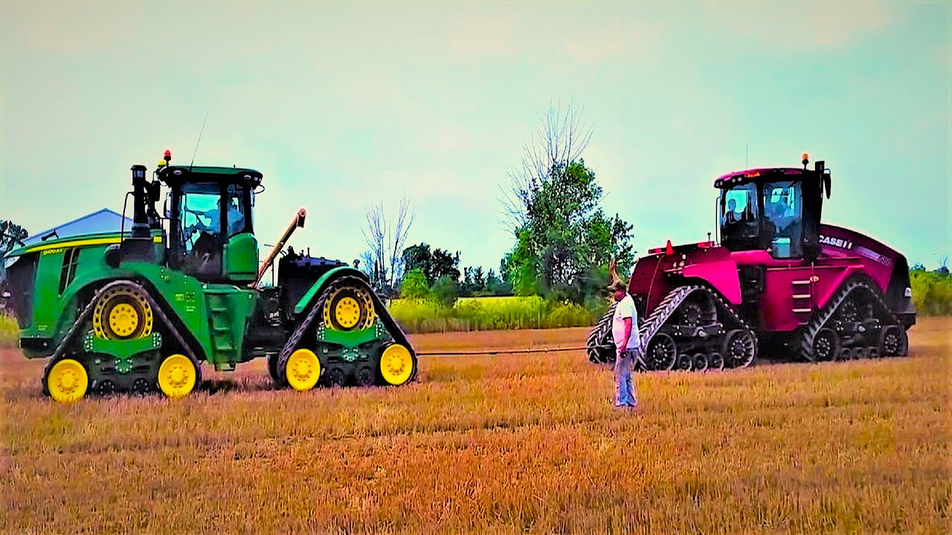
Where Are We Now?
Notes:
If you’ve heard me talk before, you know I’m a guy who uses pictures to describe market conditions.
So, as I prepared for this seminar series, I thought a tug-of-war picture might be the best description of what we have going on right now. Because we have market influences that are all pulling on each other.
This is a different story to tell from 2020 – early 2024 when everything seemed to be going great in one direction.
The story has been different for the past year – not all good and not all bad.

Slide 5

The 2025 farmland market…
Midwest Farmland Values
Notes:
So, let’s start our discussion today by making sure everyone knows where the land market currently stands…

Slide 6
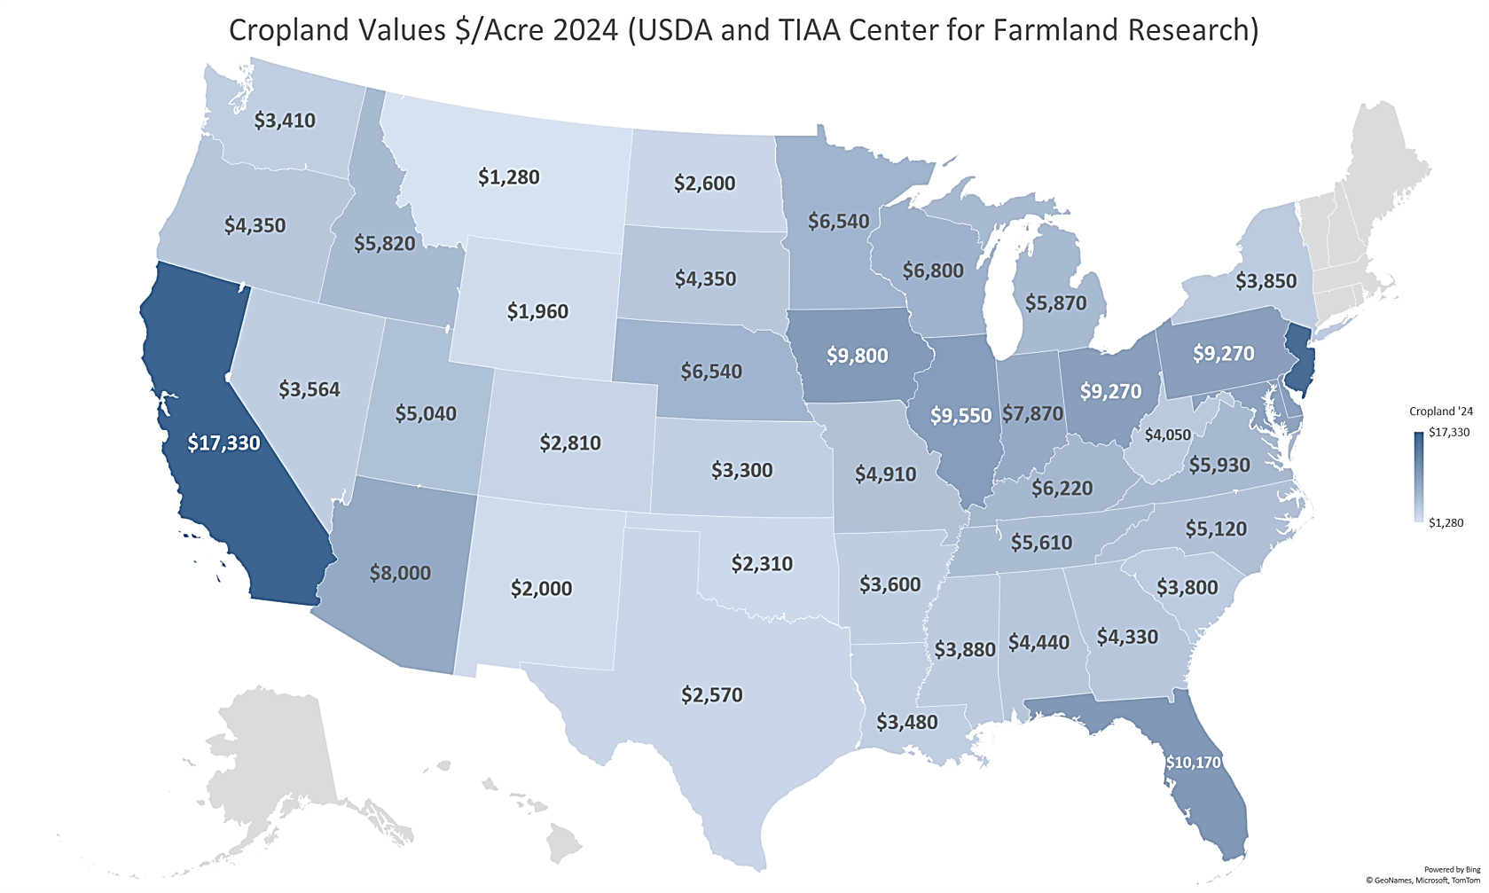
U.S. Farmland Values
Source: University of Illinois TIAA Center for Farmland Research & USDA
Notes:
This is a land values map from USDA that is published every fall. It shows average cropland values for each state. Wherever you see darker blue is where you will find the highest average land values.
In the Midwest, it’s Iowa and Illinois…

Slide 7
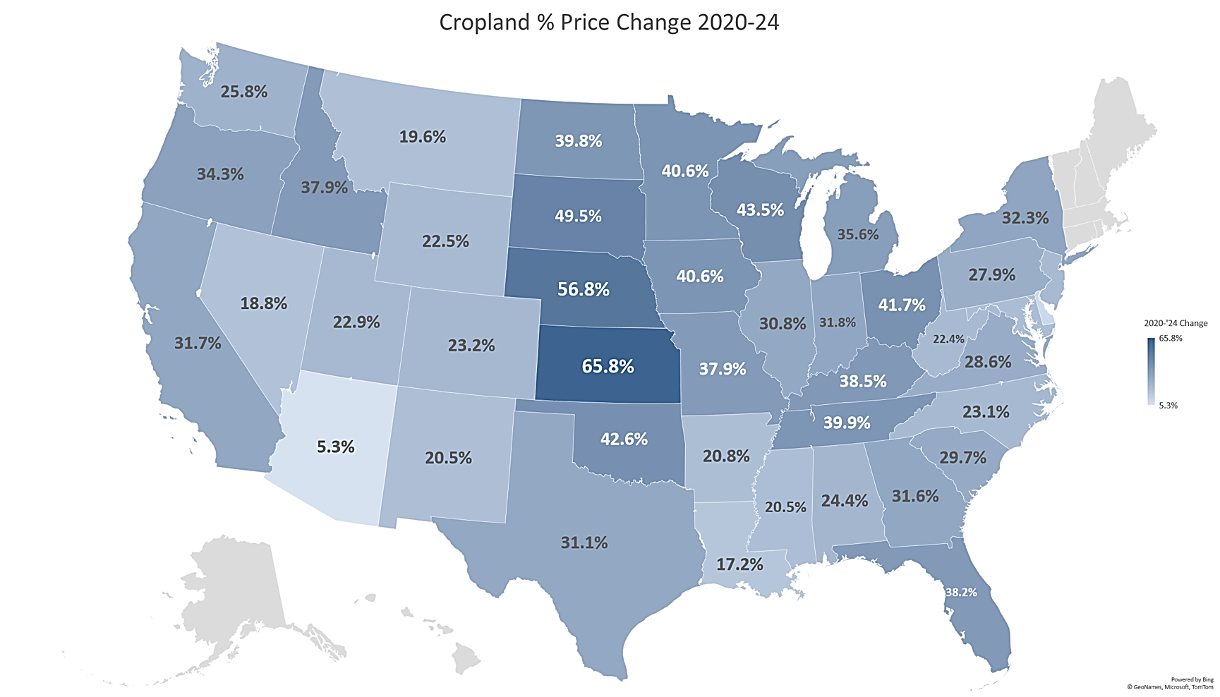
U.S. Farmland Values – 2020 to 2024
Source: University of Illinois TIAA Center for Farmland Research & USDA
Notes:
This next slide of USDA data gives us an intermediate term understanding of just how dramatically land values appreciated beginning in 2020 and running through the end of 2024. This does not include income returns… just average price appreciation.
31% in Illinois… 32% in Indiana… 40ish% in Iowa… 40ish% in Minnesota… nearly 57% in Nebraska
Impressive, considering the income component of total return is not included in these figures.

Slide 8
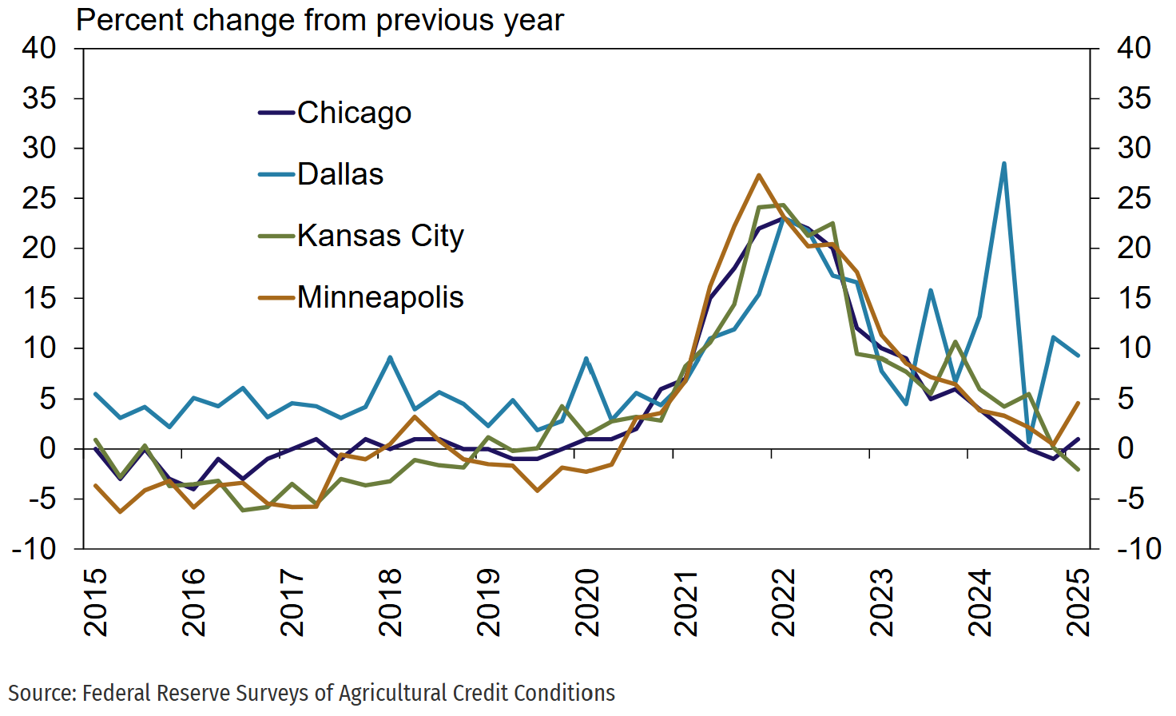
Farmland Values Trend – Long Term
Notes:
This next slide is a compiled chart and map from the 4 core Federal Reserve Banks across the breadbasket of our country. And compared to actual numbers, this chart gives us a great indication of the current trend or direction of the market over the past 10 years.
This does not say anything about value… it just describes the direction and rate of change in the land market, based on a 4-quarter trailing average change in land values.
Land values for the Chicago, Kansas City, and Minneapolis districts are following a similar overall pattern, on a year-over-year view, with a general leveling out and deceleration from land value increases in recent years. The Dallas district has shown a little more volatility.
But the key takeaway here is that the land market has flattened, more or less, over the past year… whereas a couple years back things were up-up-and-away.

Slide 9
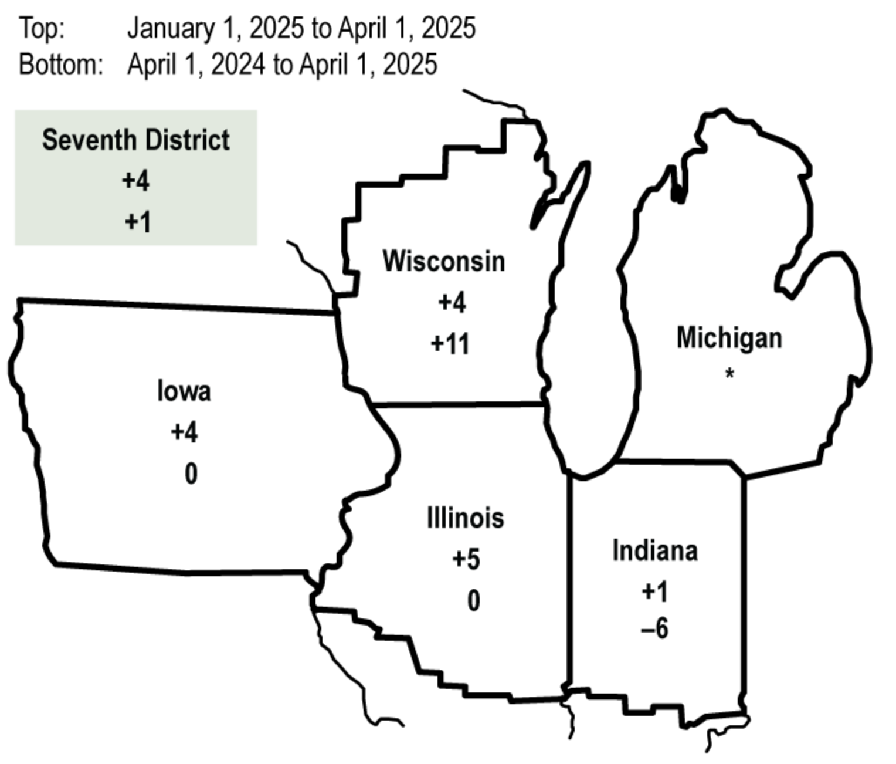
Chicago Federal Reserve Survey
Percent Change in Dollar Value of “Good” Farmland
January 1, 2025 April 1, 2024
to to
April 1, 2025 April 1, 2025
Illinois +5 0
Indiana +1 -6
Iowa +4 0
Michigan * *
Wisconsin +4 +11
Seventh District +4 +1
Top: January 1, 2025 to April 1, 2025
Bottom: April 1, 2024 to April 1, 2025
Source: Federal Reserve Bank of Chicago, AgLetter, No. 2008, May 2025
Notes:
And that flattening has now shown up in sales and survey data.
And if we zoom in a little more on the upper-Midwest with the most recent quarterly readings, this May 2025 report from the Chicago Fed shows how the price appreciation from recent years has flattened in total, particularly for the “I” States, which is what we’re most focused on here.
But, it’s not exactly been a straight line. Q1 here in 2025 has shown strength, which essentially backfilled some land value slippage that occurred in the 2nd half of 2024… to now mostly leave us a flat market year-over-year.
Wisconsin has showed a little more ongoing resilience comparatively speaking over the past year… and we will talk about why here in a few minutes.

Slide 10


Iowa RLI & Iowa State University
March 2024 – September 2024 –5.0%
September 2024 – March 2025 –1.0%
March 2024 – March 2025 –6.0%
December 2023 – December 2024 –3.1%
Source: Iowa RLI & Iowa State University
Notes:
Getting state specific… the Realtors Land Institute in Iowa publishes a survey of brokers and auctioneers every 6 months… in March and September each year. This report generally affirms what the Chicago Fed report shows, although on slightly different survey timing.
Looking back and through all the data, it seems mid-late 2024 were when we saw the most weakness in the Iowa land market, before then firming right around the end of the year and in early 2025.
Again, on different survey timing, the ISU Extension land values survey affirms much of this swoon in mid-late 2024.

Slide 11
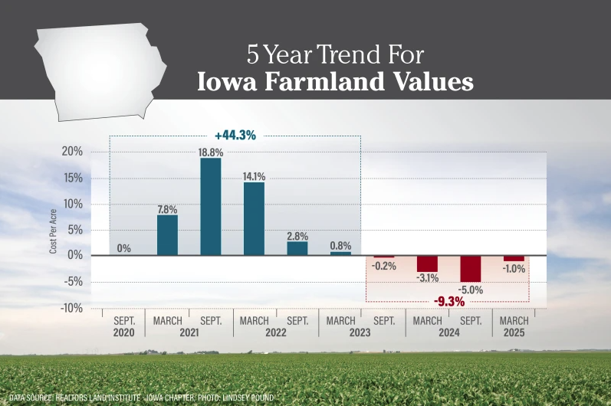
Source: Iowa RLI Compiled Data
Notes:
This is another chart that is very helpful for visualizing the past 5 years in the Iowa market, specifically.
While the exact numbers would be different, most surrounding states would follow a similar pattern of market movement.

Slide 12
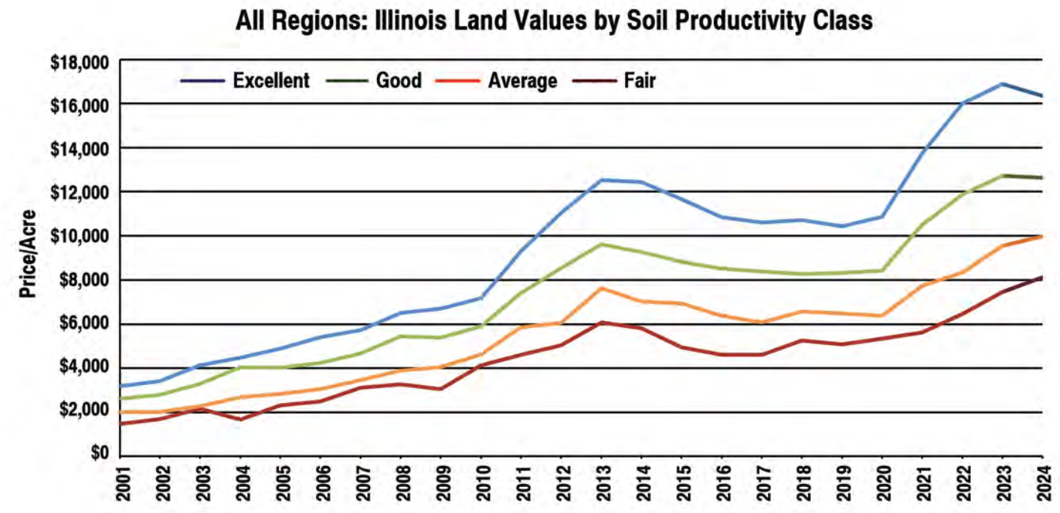
Illinois – 2025 Land Values
Source: ISPFMRA March 2025
Notes:
Let’s go east of the Mississippi…
What I’m showing you here for Illinois is a chart with survey results from the Spring 2025 Illinois Society report, which is really the only complete data-driven update that the Illinois Society provides annually. There is normally a mid-summer update that is announced to report of Q1 & Q2 sales performance, but we don’t have that data yet.
This dataset shows a softening in the Illinois market year-over-year… and in digging into the data itself, you’d find the most pronounced % drop in the top end tillable land and in transitional land in Illinois. The data itself ranges from 3 to 8% weaker year-over-year, depending on the region you are in.

Slide 13
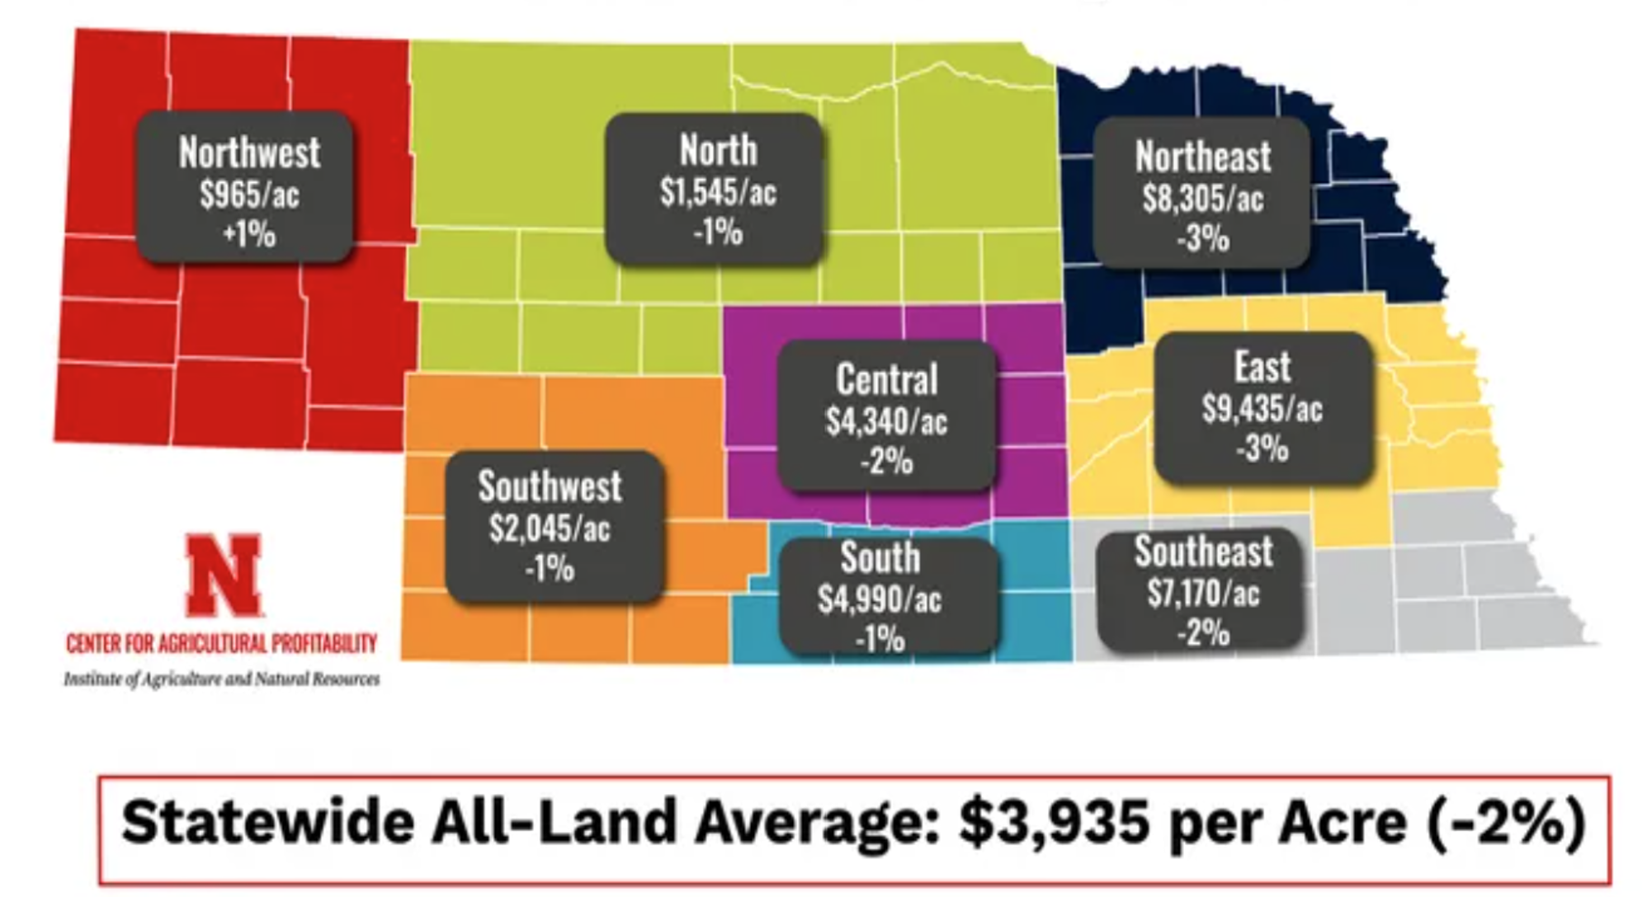
Nebraska – 2025 Land Values
Source: University of Nebraska at Lincoln, Spring 2025
Notes:
Let’s fly out west to Nebraska… results in Nebraska are mostly lower by a few % across each region. However, row-crop land was even weaker than is reflected here, because grazing land and pasture is factored into the averages, and livestock-related land was actually stronger year-over-year.
So, there has emerged a divergence between the livestock and row-crop grains sector. We will talk a little more about that in a bit.
Remember… these surveys don’t show you the value of your farm… rather, they simply reflect a direction of the market in each state.

Slide 14
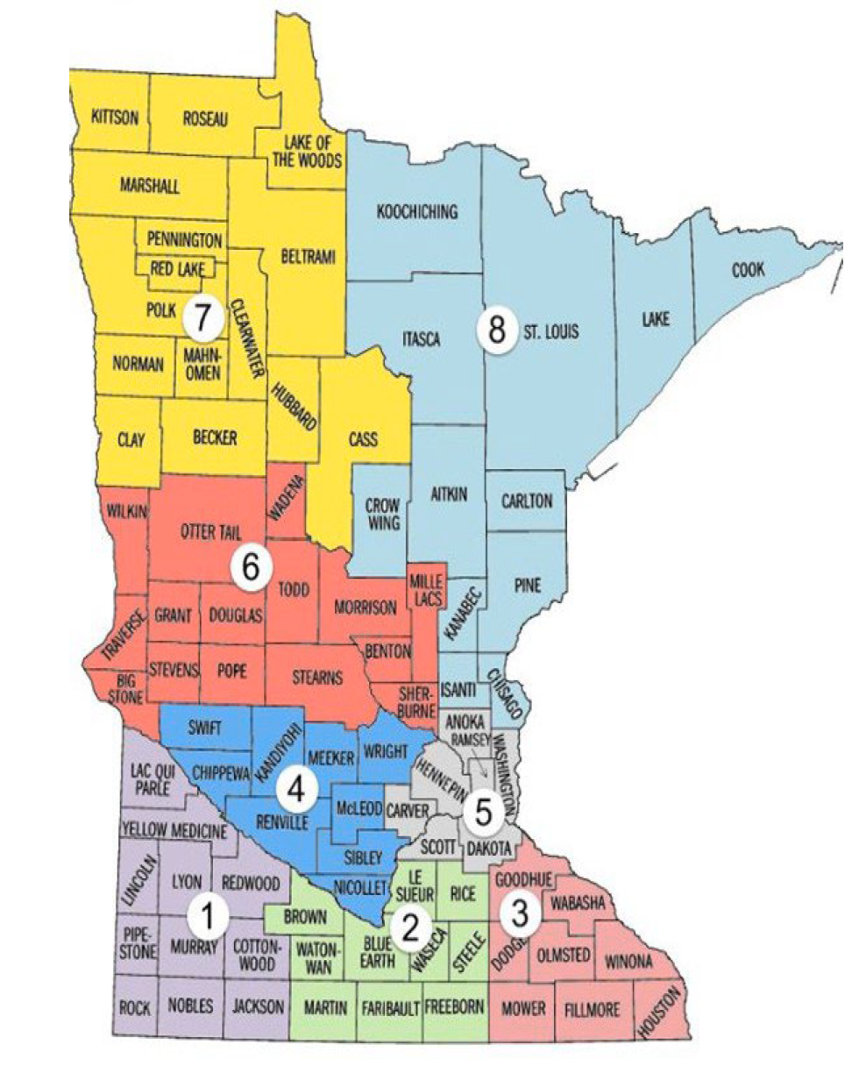
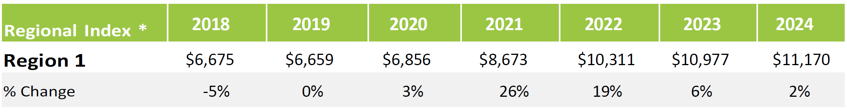
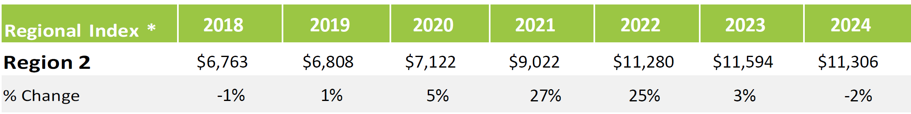


Minnesota – 2025 Land Values
Source: Minnesota ASFMRA, Spring 2025
Notes:
Up in Minnesota, the story is similar. In early 2025, the Minnesota Chapter of Professional Farm Managers and Rural Appraisers reported year-over-year weakness in the southern region of the State, where row-crops influence the land market most heavily. Clearly a slowdown from a couple years ago when land values in these same regions commonly appreciated at +20% year-over-year.
And I also want to note… in those areas of southern Minnesota that were flooded out in 2024 and raised 150-bushel corn and 45-bushel soybeans last summer, the land value numbers can look even weaker. So, remember that values and local strength or weakness are also very dependent on local conditions.

Slide 15
What’s driving the Land market?
-Farm income
Midwest Farmland Values
Notes:
So, that’s a really quick flyover of where our land markets here in mid-2025.
As we look ahead, let’s spend some time talking about those factors we believe are most heavily influencing our current market…
==
Now, the first and most important factor that drives Midwestern farmland values is the revenue generated by our farms, and the underlying price of corn and soybeans. Intuitively, I think we all understand that.

Slide 16
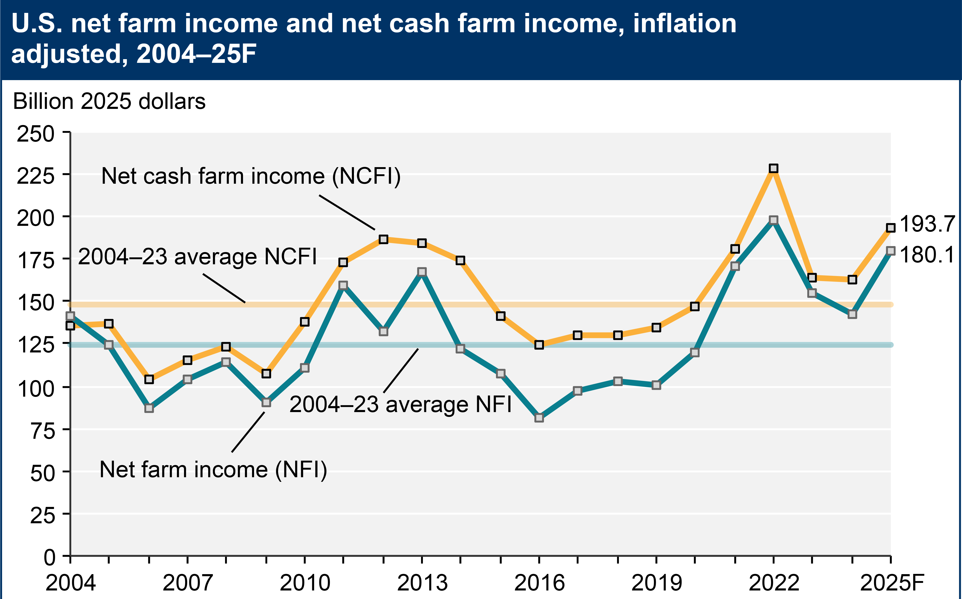
More Farm Income in 2025?
Source: USDA ERS, February 2025
Notes:
USDA publishes Net Farm Income reports 3x each year, and this forecast chart shows more income being earned in 2025 than in 2024.
Does that surprise anyone?
For the next few minutes, I want to spend a little time talking about where the income on this chart is coming from…
And what you will soon learn is that not all of this income is coming directly from farm activities. We will talk more about what I mean by this in a few minutes.

Slide 17
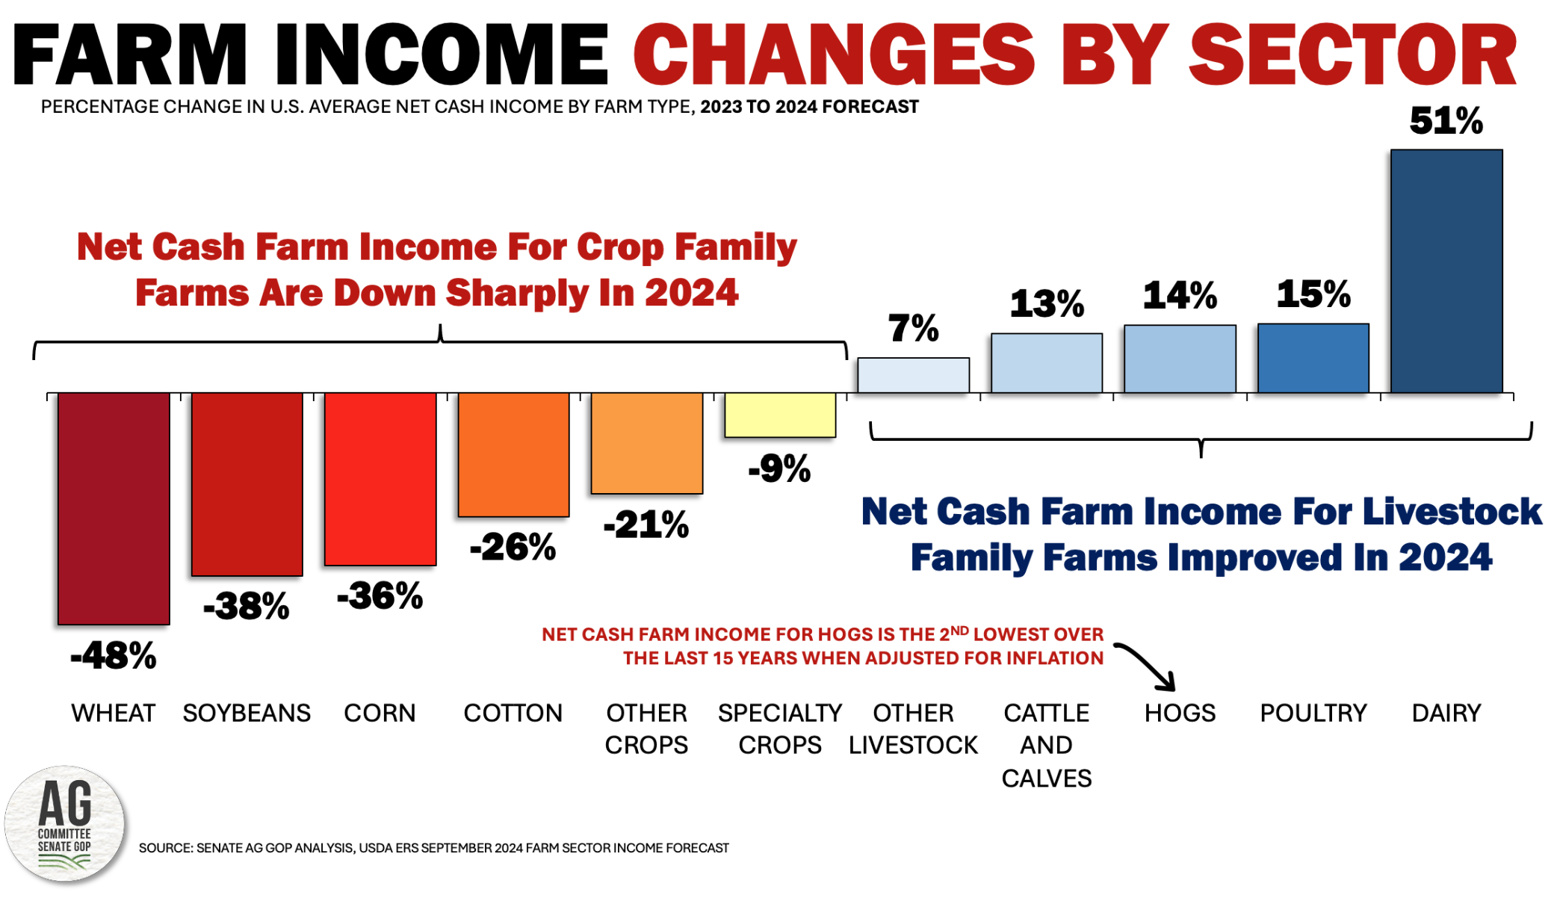
Source: U.S. Senate Ag Analysis, September 2024
Notes:
Here’s the farm-related income and revenue story from 2024 on a sector-by-sector basis.
This chart pretty clearly shows a divergence in profitability between row-crop agriculture and livestock agriculture in 2024.
And for most of us in the room who are most focused on row-crop or grain-driven agriculture, this income squeeze in 2024 is generally why we saw a slight squeeze on land values in late 2024… because row-crop farming was not very profitable last year.
But good on our livestock focused brethren! The livestock folks have suffered through times of weak profitability many times before. And if you ask any of our hog growers, they’d tell you things still aren’t good. But dairy cattle, beef cattle, and the poultry sectors have been pretty good for a couple years now.
This is why we saw that isolated land value strength up in Wisconsin (Chicago Fed Survey), and out west with pasture and grazing land in Nebraska (UNL Land Value Update).

Slide 18
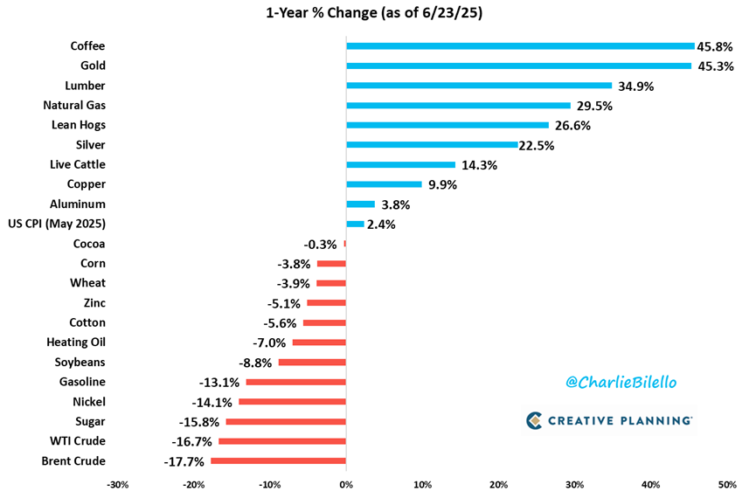
More Farm Income in 2025? – TTM
Source: Creative Planning, June 2025
Notes:
Here in the first half of 2025, the commodity sector splits have largely remained on the 2024 path.
Corn, soybeans, wheat, and cotton are all weaker year-over-year… while hogs and cattle are again stronger year-over-year, as of the end of June when this deck was put together.
Helps you understand why a ribeye steak is so expensive when you go to the meat counter at your local grocery store.

Slide 19
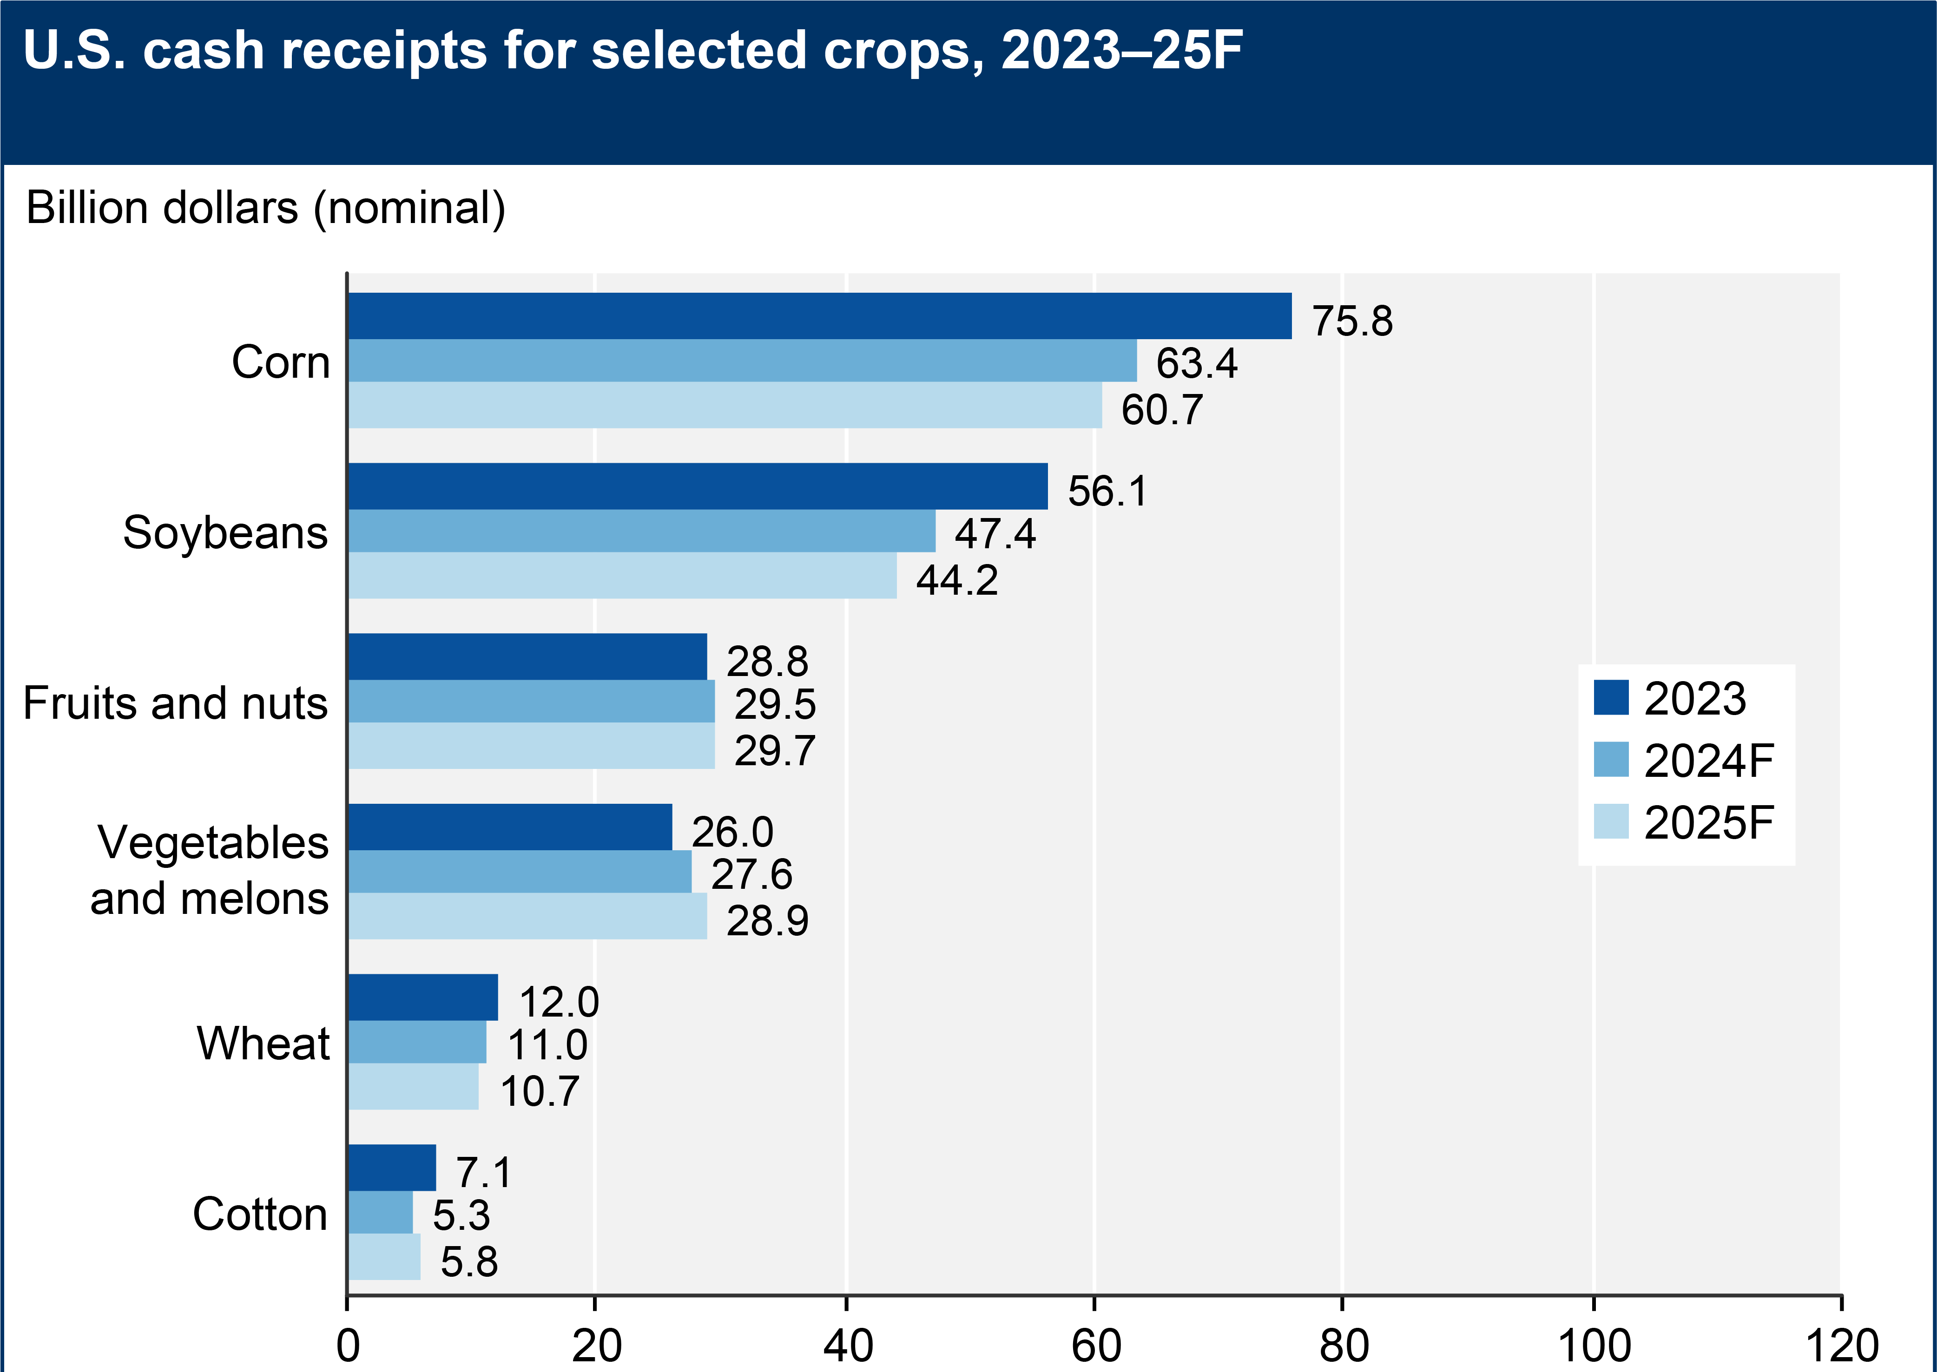
Revenue in 2025 – Row Crops
Corn… -20%
Soybeans… -21%
Source: USDA ERS, February 2025
Notes:
To get even more granular, let’s look at how farm revenues have trended from 2023 to today.
As mentioned earlier, for the majority of us in the room, corn and soybeans are our primary crops.
In terms of revenue produced for these row-crops, USDA showed 2024 was pretty tough-sledding for corn and soybean farmers… and 2025 is expected to be even a little worse. Over this period, revenue from corn is estimated to be down 20%, and revenue from soybeans down 21%.
Remember… Revenue comes from 2 components – the quantity sold and the price at which it was sold.
For both corn and soybeans, this revenue issue was and is more about price than bushels.
So, to outrun this problem at the farm level, we need to grow more bushels… which we are trying to do!

Slide 20
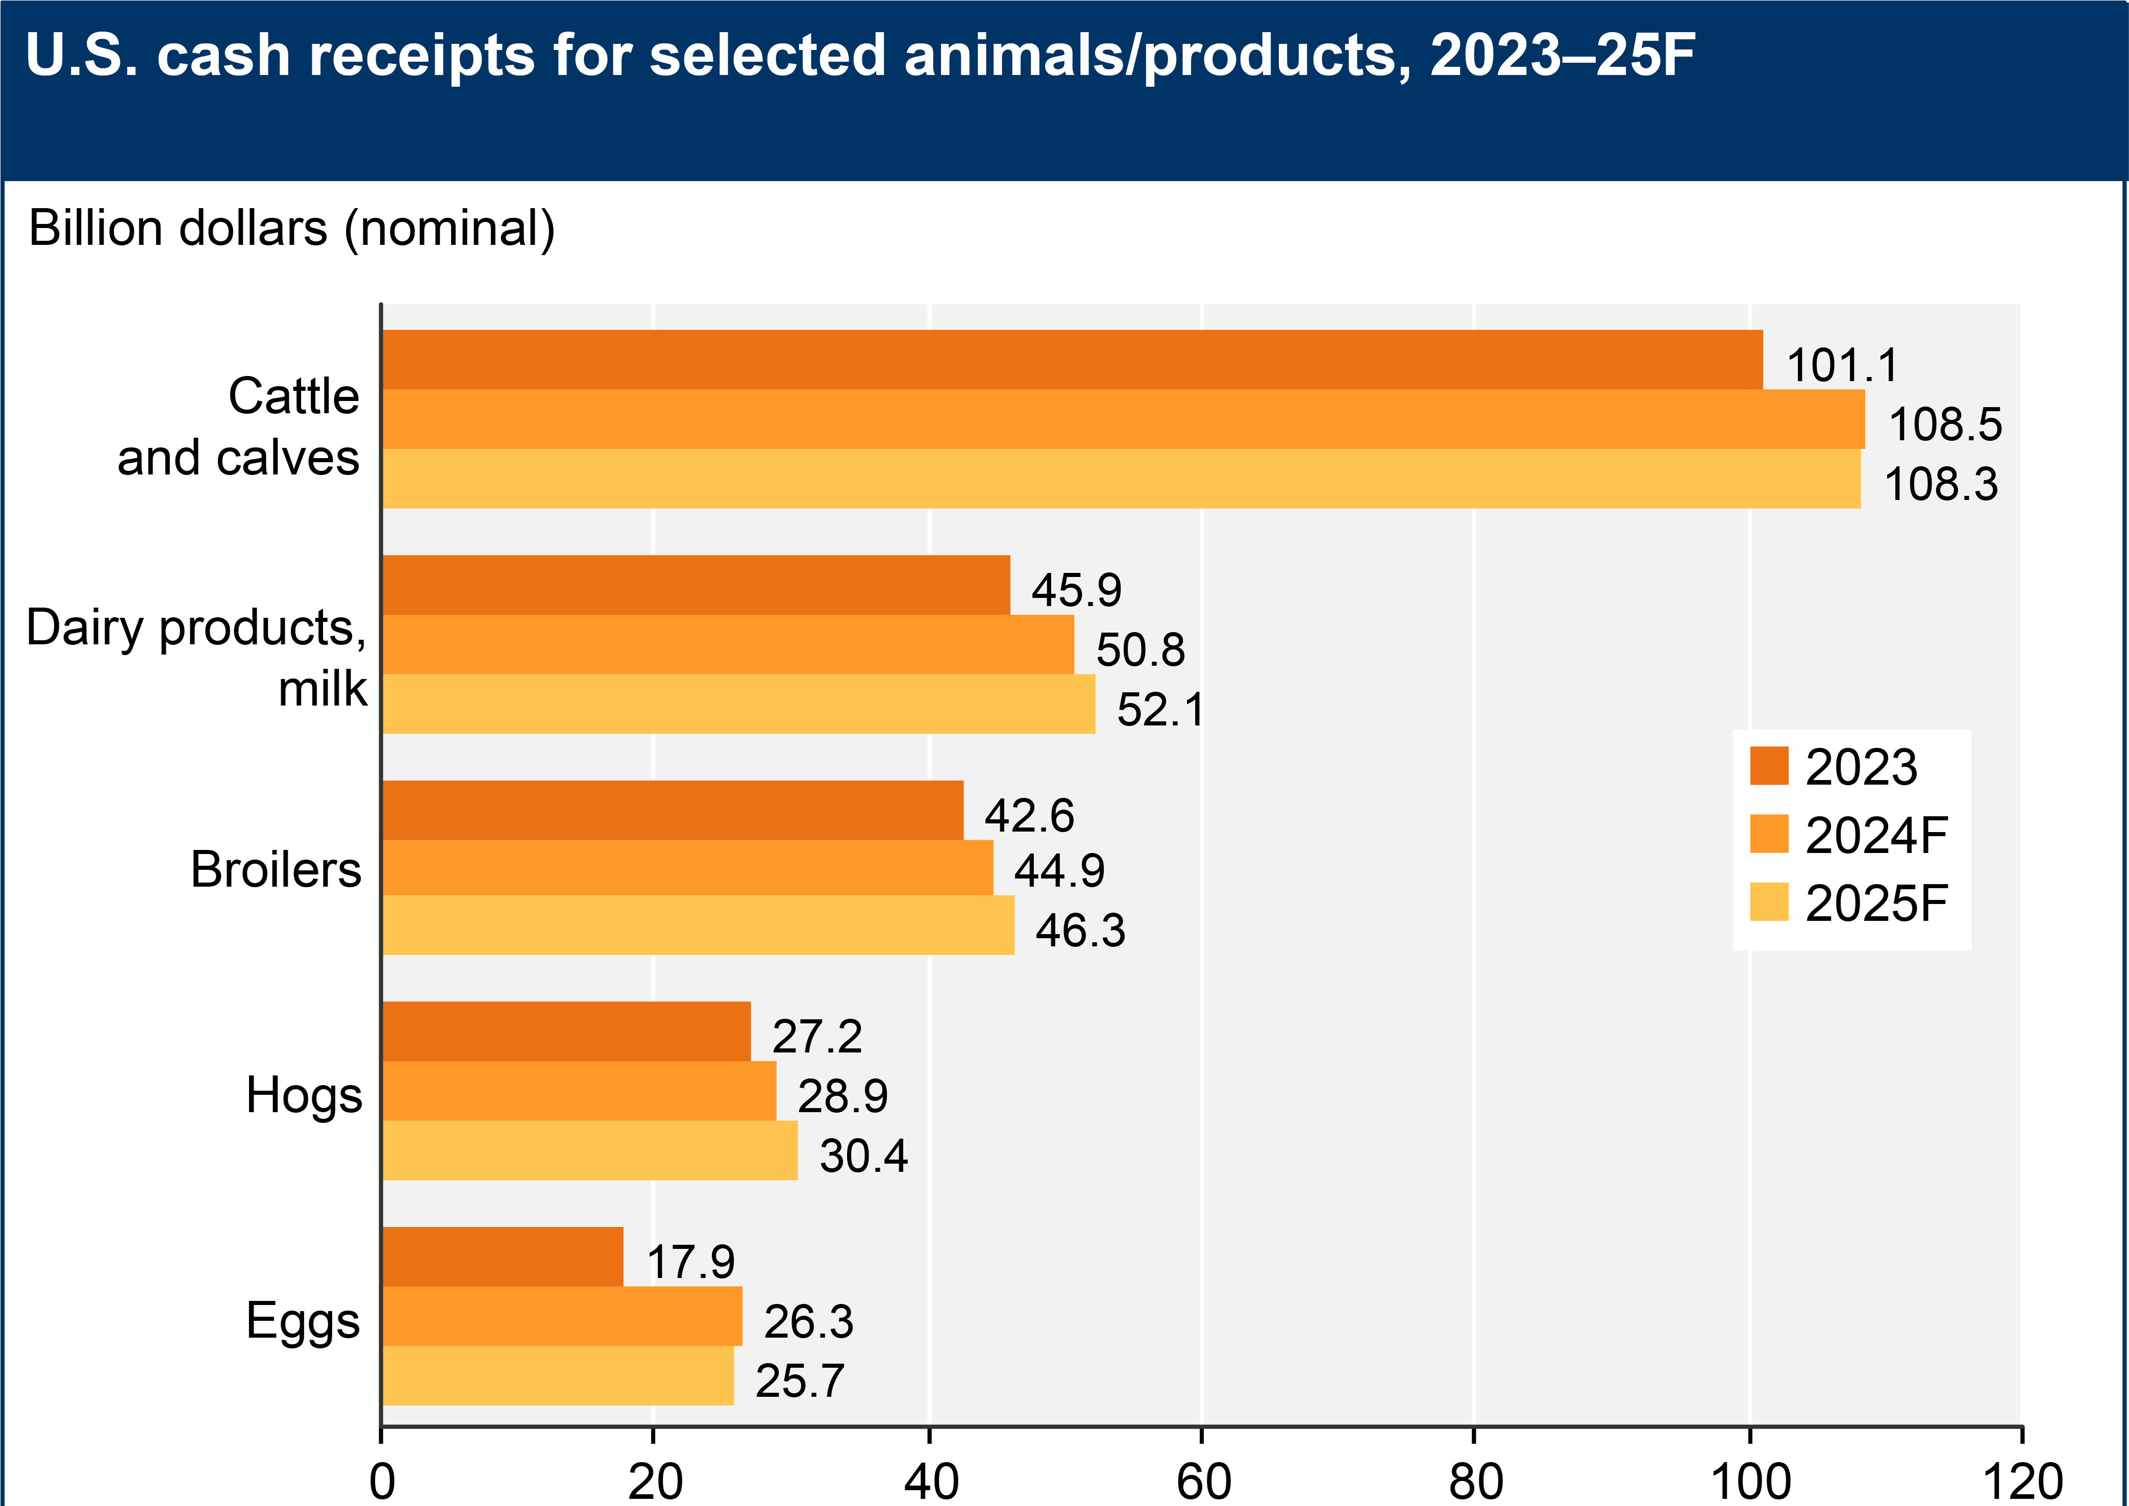
Revenue Sources – Livestock
Cattle… +7%
Dairy… +13%
Broilers… +8%
Hogs… +12%
Eggs… +43%
Source: USDA ERS, February 2025
Notes:
On the flip side, USDA showed 2024 as an improved year for most livestock producers, and for the most part, 2025 is lining up similarly, if not even just a little better.
Revenues earned expanded in all these livestock sectors, and that was mainly because of higher prices.
Again, why your ribeye has been more expensive the past couple years.
And eggs! Anyone here know what happened with eggs? (High Path Avian Influenza devasted laying hen industry, thereby making eggs more costly.) That supply stream is beginning to normalize again, fortunately.

Slide 21
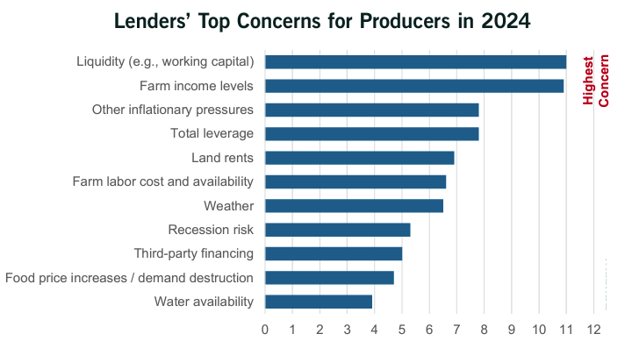
Row-Crop Bankers Are Concerned…
Source: ABA-Farmer Mac Survey, Q3 2024
Notes:
But for those of us most focused on row-crops, the past couple years have been tough.
And agricultural lenders working with row-crop farming operations have been concerned with weak cash-flows, weakening liquidity, and weak to negative farm incomes.

Slide 22

It’s Not All Bad News…
Notes:
Have I depressed you enough yet?
I do want to say, it’s not all bad news…

Slide 23
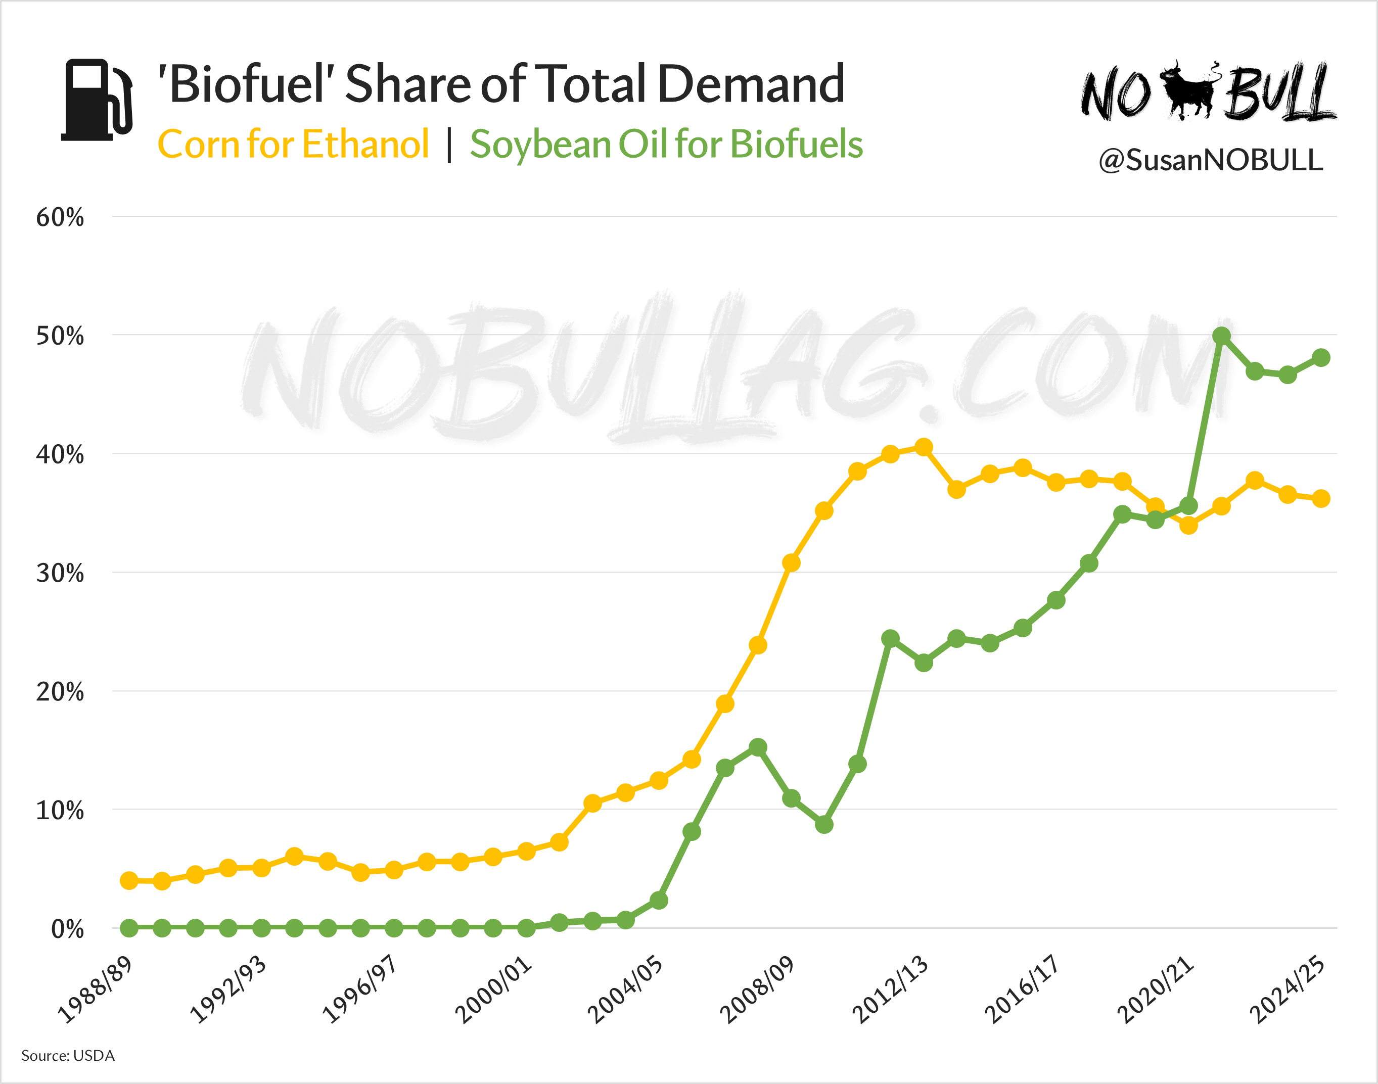
Source: NoBullAg.com, June 2025
Notes:
And as you may have heard said before, the cure to low prices are low prices. And that’s what has been happening in the Biofuels business – both ethanol and Renewable Diesel fuel, specifically.
This chart shows the % of each crop that is being utilized in the production of ethanol in the case of corn, and soybean oil for soybean based biofuels. In each case, 40-50% of each commodity is being consumed to make fuel.
This is good news for the corn and soybean markets, long term!

Slide 24
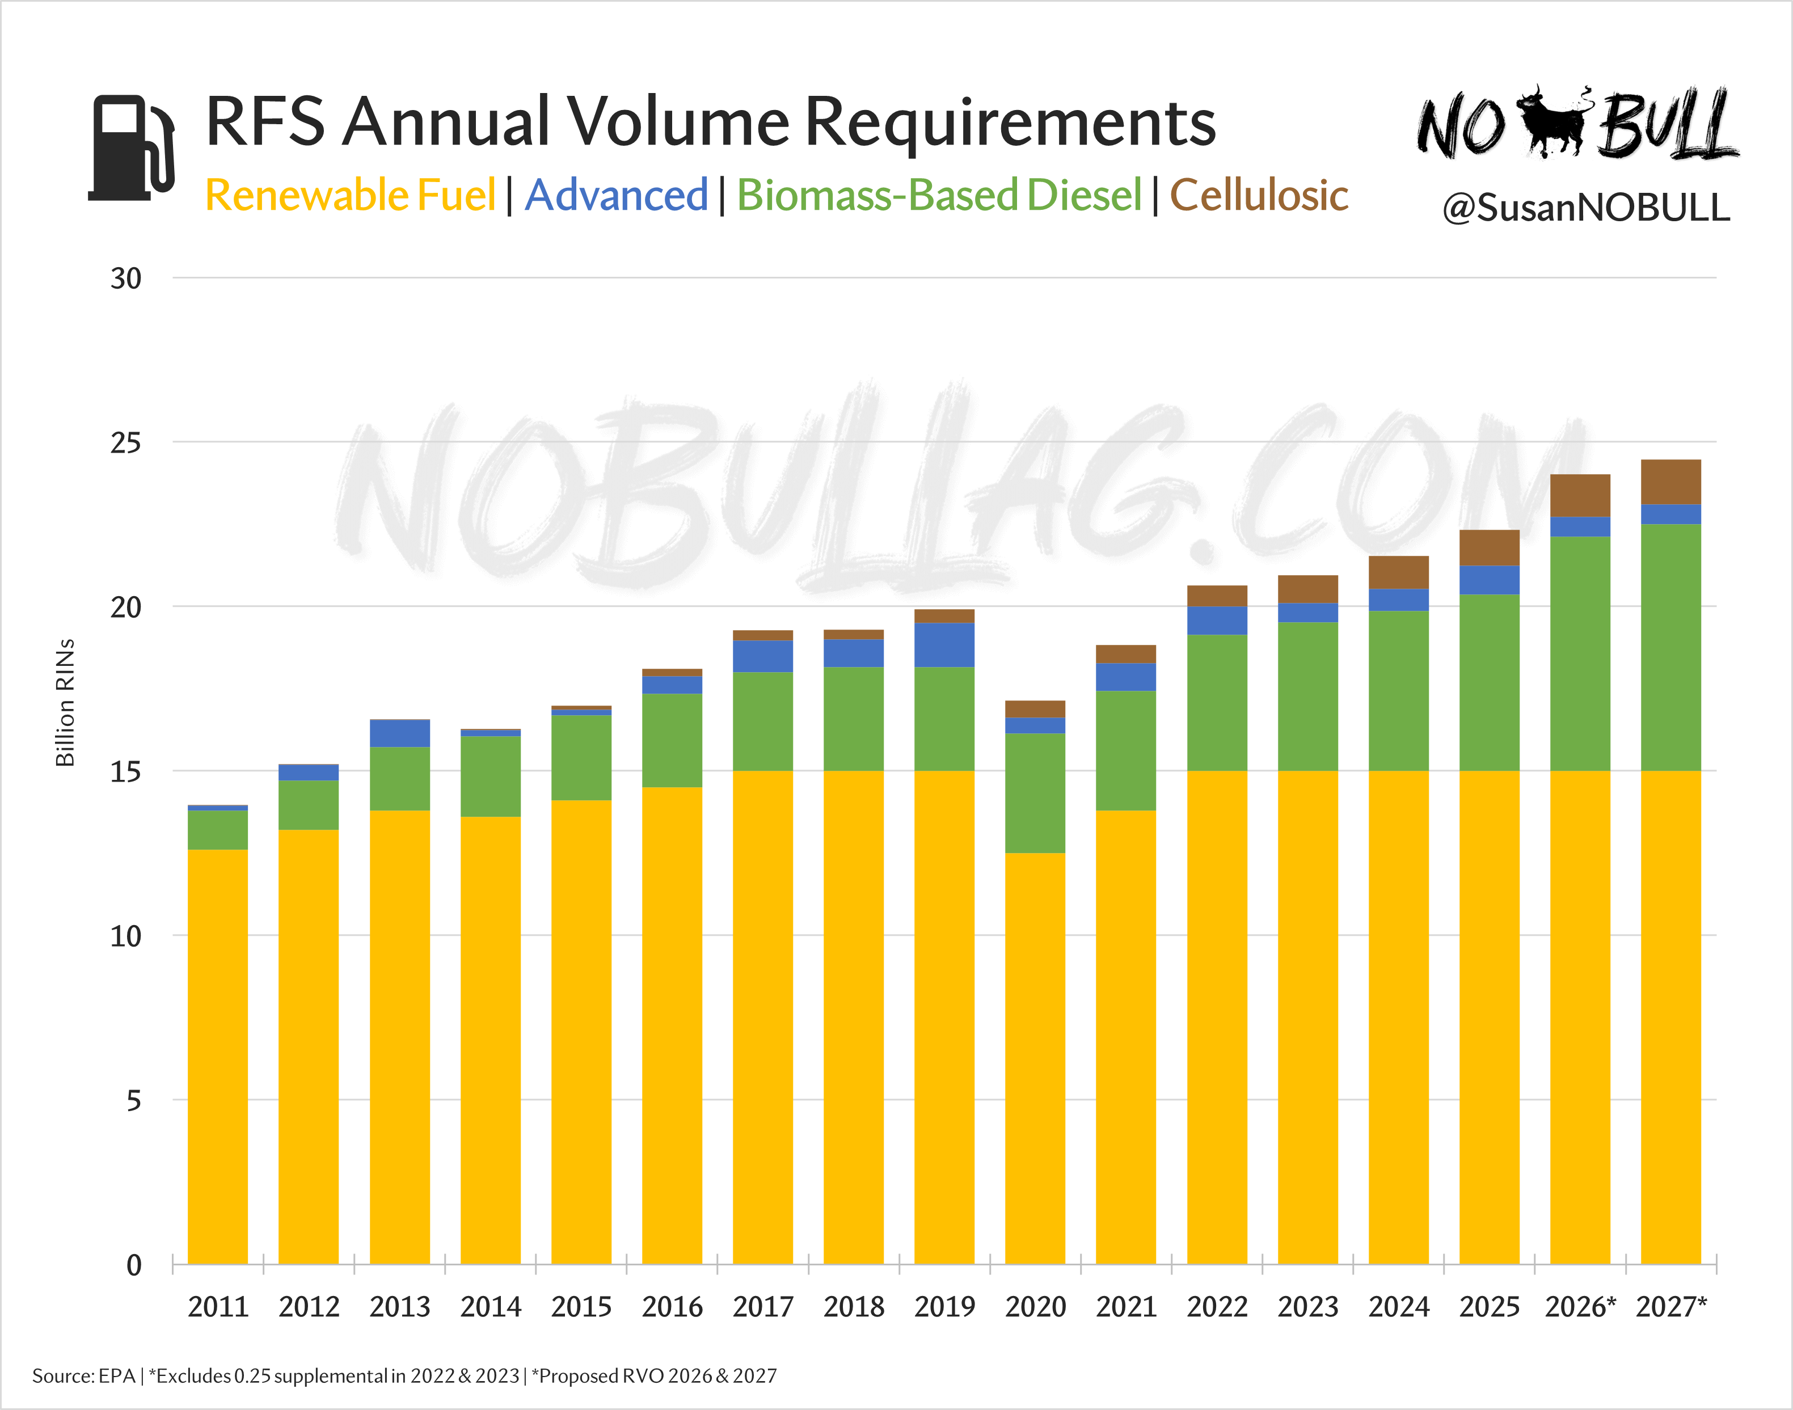
Source: NoBullAg.com, June 2025
Notes:
And with recent EPA movements and legislation embedded in the “One Big Beautiful Bill”, biofuel volume requirements in the Renewable Fuels Standard are expanding, particularly on the biomass based diesel.
This expansion for biomass based diesel doesn’t directly impact corn, but it does directly impact soybeans to the positive… and the crop-mix battle is expected to indirectly help pull corn higher, as well.

Slide 25
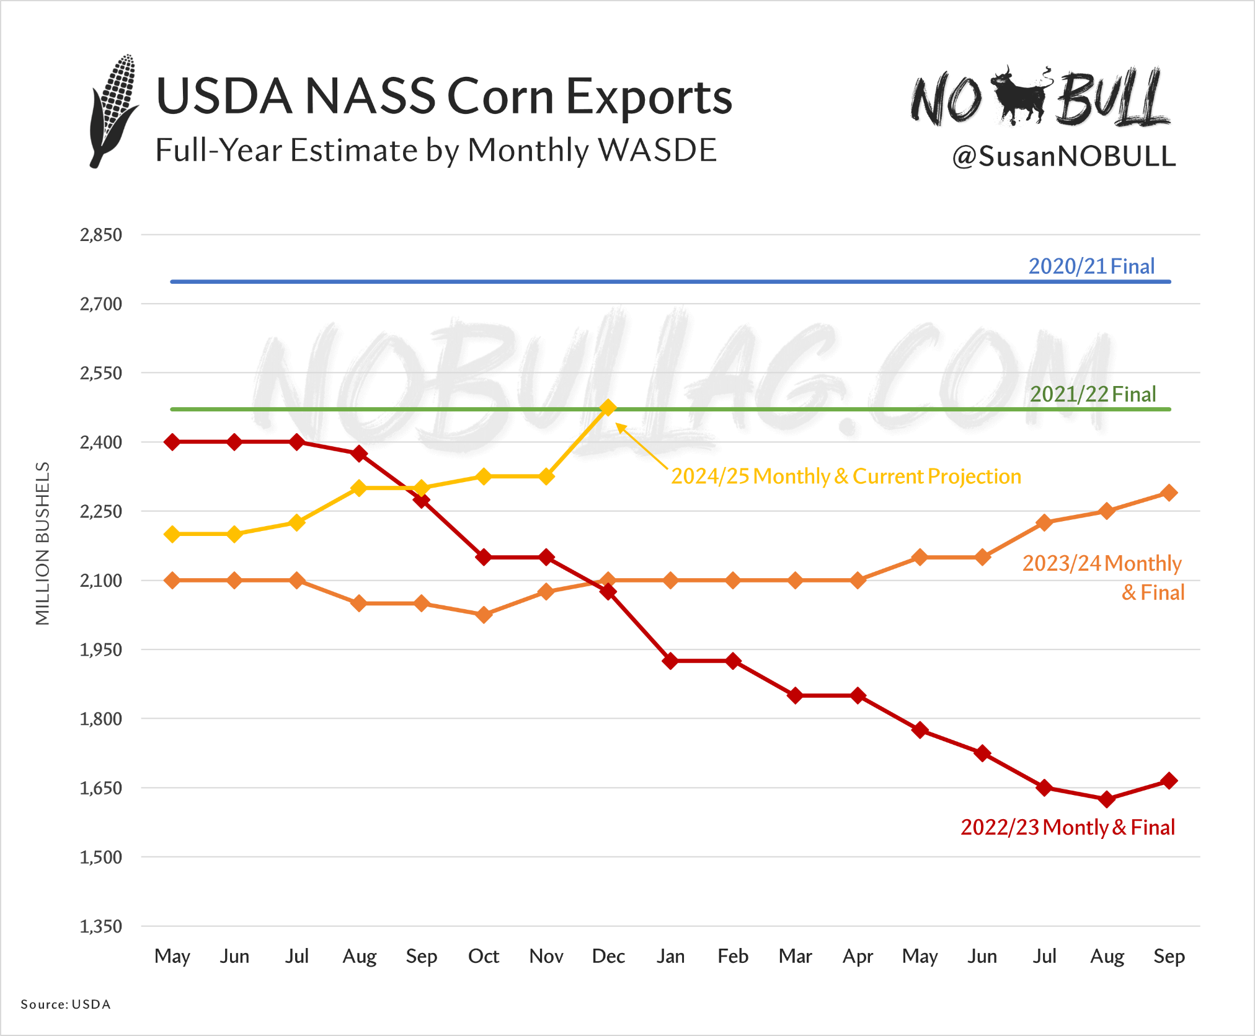
Source: NoBullAg.com, February 2025
Notes:
Similarly, Corn Exports started the 2024/2025 marketing year on a very strong pace. This is one of the main reasons we saw the corn market scratch and claw its way back in early 2025.
We’ve clearly given back some of those gains from early this year, but that’s mostly attributable to this monster corn crop we are currently growing.
But corn exports have clearly been stronger this year than in recent years… And as this chart shows, USDA is forecasting the biggest export business in our current marketing year since the period from 2020 and 2021.
Does anyone remember what happened in those 2 years?
(China was buying coming off the Phase 1 of Trump’s trade deal from the end of his first Presidential term.)

Slide 26
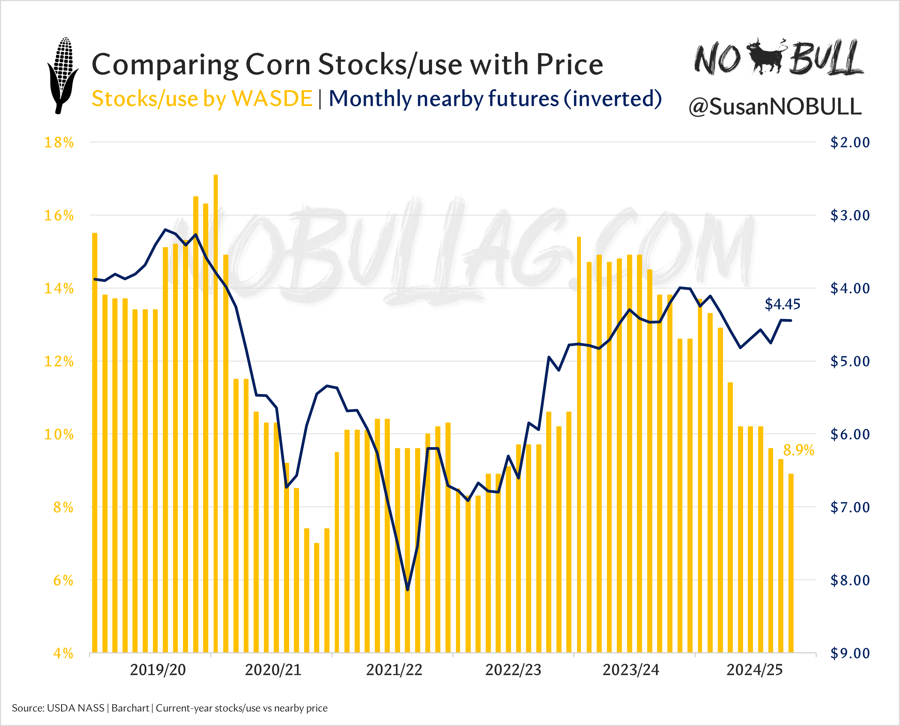
Source: NoBullAg.com, June 2025
Notes:
I also included this chart in the “Good News” section for farm income, because of what it shows.
Basically, in the recent past, when corn stocks have been as tight as they currently are, we have seen corn prices really rally.
This has not happened in 2025 in the same way it generally does. And I would attribute the market’s different reaction this year to 1, maybe 2, things…
First, 95.3 million acres of corn planted is going to make a HUGE pile of corn this fall… likely a record crop. So, in contrast to past years when stocks were this tight, the market is saying, “we don’t think there’s a shortage”.
The other issue at play, likely to a lesser extent, is the tariff disruptions that have been present the past few months. There may be some expectation that corn buyers will go elsewhere to buy corn, notably Brazil.

Slide 27
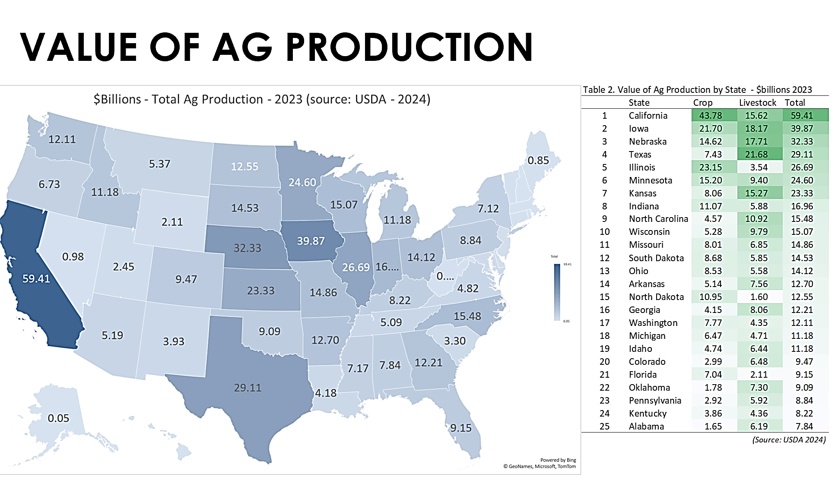
Source: University of Illinois TIAA Center for Farmland Research & USDA
Notes:
The last thing I wanted to show you about why farm income and land values are locked together, comes from USDA.
This is mostly just a FYI and trivia piece. And I think this “Value of Ag Production” data can help give you a frame of reference for how the various states stack up when it comes to dollars and cents in ag products.
Iowa (2), Nebraska (3), Illinois (5), and Minnesota (6) are all Top 6 States.
And I think this chart explains why focus is given to certain states when it comes to the discussion about ag policy, in general.

Slide 28
What’s driving the Land market?
-other revenue sources
Midwest Farmland Values
Notes:
Beyond corn, soybean, and livestock sales, there are other revenue sources that matter to Midwestern agriculture and our farms.

Slide 29
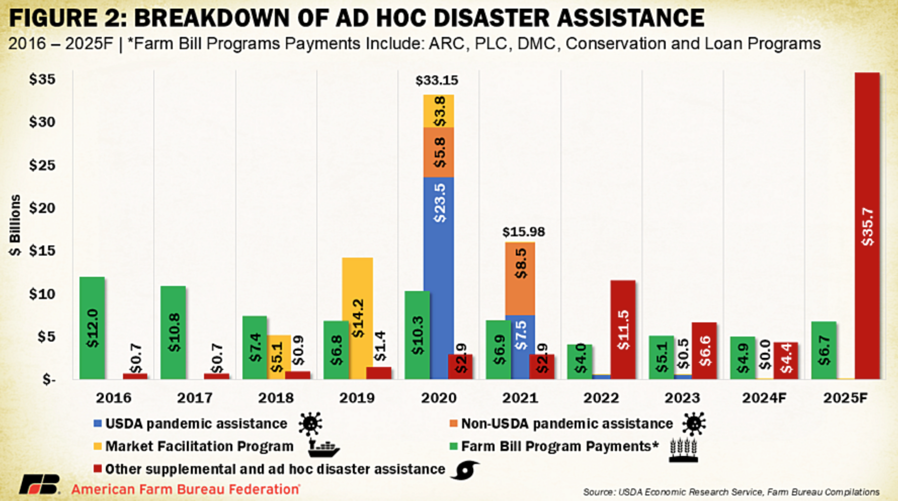
Gov’t Disaster Aid is On The Way…
Notes:
And this chart shows one of those revenue sources that none of us really want to talk much about. And that is Government payments and support. This chart shows various direct government payments made to US farmers over the past 10 years.
Remember on the USDA Net Farm Income Chart several slides ago when I said not all the income reflected is from farm-related activities? This is specifically what I was talking about.
What you will notice with this chart is that there are 2 years when the bar is really tall… one of those is here in 2025, and the other was back in 2020.
Essentially, ad-hoc government spending in agriculture exploded in those 2 years. 2020 was related to COVID, and the spending in 2025 was from a budget bill that was passed in late December 2024 by the Biden Administration.
$10 billion in direct payments for US farmers. ~$43/acre for corn and ~$28/acre for soybeans from the 2024 crop year. Some of you in this room no doubt benefitted from these payments that were made this spring. This type of immediate injection clearly showed up and provided some cash buffer and confidence across the countryside. The other $25 billion in adhoc spending here was designated for hurricane disaster relief from last year along with some other programs.
But these government dollars are a part of the NFI calculation. So NFI can kindof mask what is really going on in agriculture, can’t it?

Slide 30
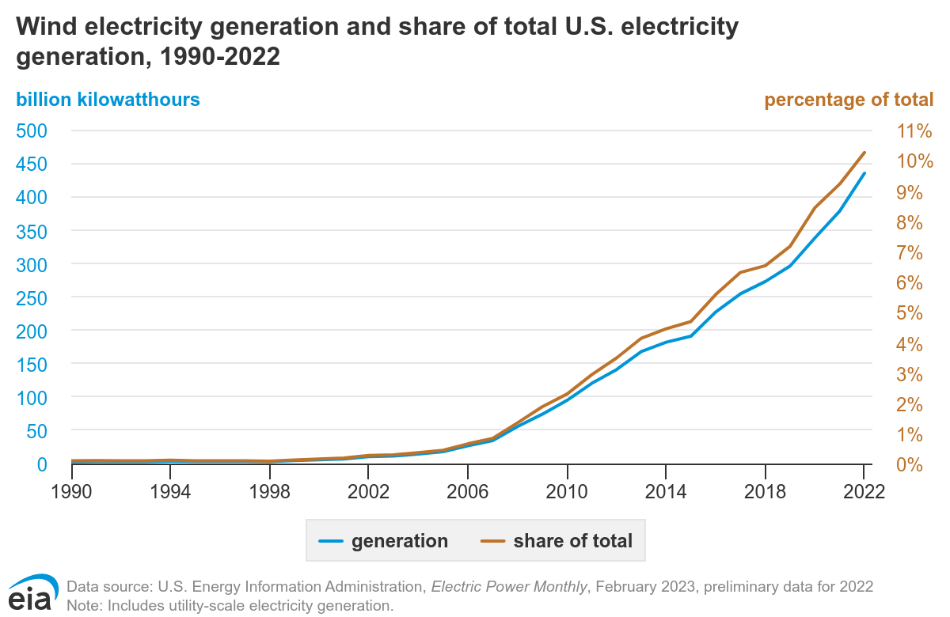
Wind Energy Growth
Source: U.S. Energy Information Administration & Electric Power Monthly
Notes:
The other major area I want to touch on regarding “Other Revenue Sources” is wind and solar energy.
This chart, which is a couple years dated, shows how wind energy has become a significant source of electricity production in our country, including here in the Midwest.
Those big wind turbines you see dotting the rural landscape provide some real revenue to the landowners who have them on their land.
It’s not uncommon for each turbine being built in the past couple years to pay upwards of $20 to $30 thousand dollars annually to the landowners on whose property they are built. Not all the older turbines pay that much, but they all pay a pretty handsome amount each year.
Yes, some people would never have them on their property, and that’s ok. But for those who do, the revenue has been meaningful… and has capitalized it’s way into area farmland values where they exist.

Slide 31
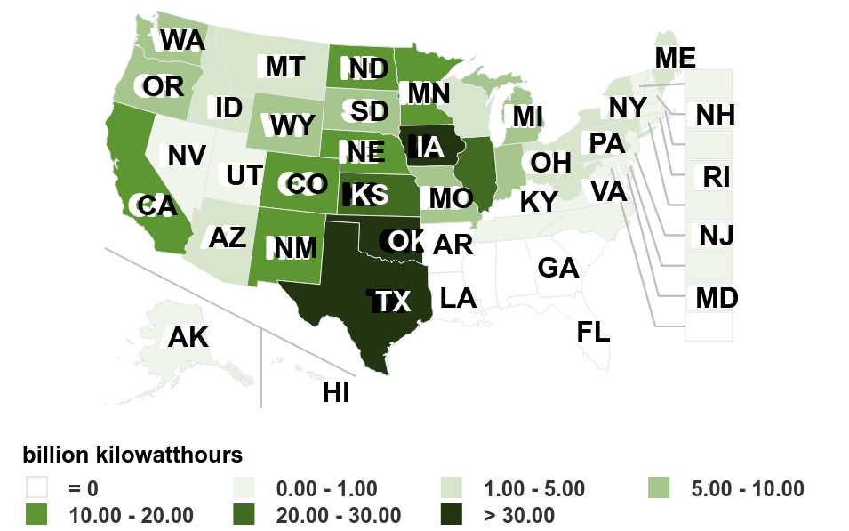
U.S. Utility Scale Wind Electricity Generation
Source: U.S. Energy Information Administration & Electric Power Monthly
Notes:
Wind power is actually the largest source of electricity generation in Iowa, making up about two-thirds of the State’s power in 2024. Iowa has over 12,500 megawatts of installed capacity with over 6,000 wind turbines, ranking 2nd and 3rd in the nation in those measures.
Texas, Oklahoma, Illinois, Kansas, Minnesota, Nebraska, and North Dakota are also major states with significant crop production sectors, while also doubling as wind energy players.

Slide 32
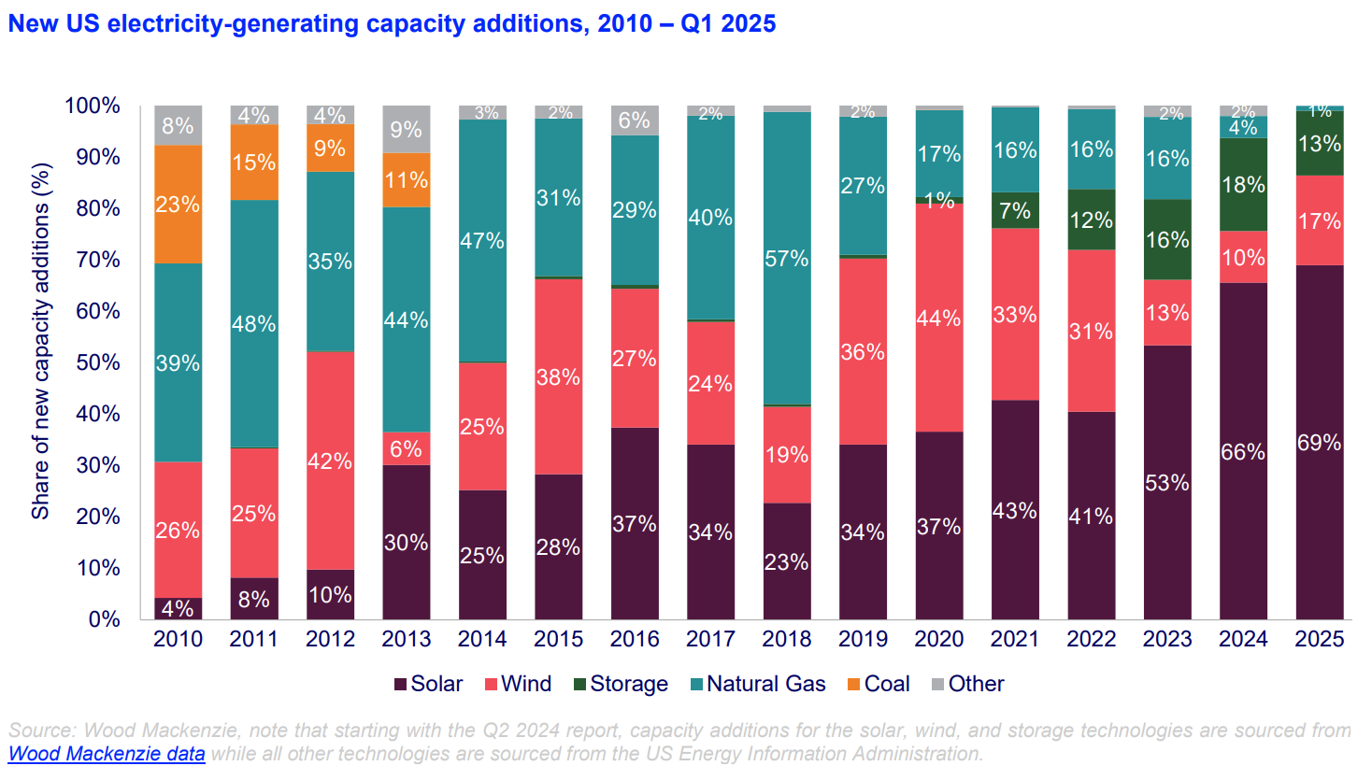
New Electricity Production – All Sources
Source: U.S. Energy Information Administration & Wood Mackenzie
Notes:
The other extra revenue source I want to mention is the Solar Energy market, which has become more common in the past 4 to 5 years. Solar farm development has especially been driven by the policy coming out of the Inflation Reduction Act legislation passed in 2022, which has really been the driver of the “green energy” movement.
There are strong opinions on both sides of that conversation as to whether any of this is good or bad, so we’re going to set that aside.
But we all know it is happening because we can see these solar developments when we drive down the road.
Anyone here been solicited? Anyone here signed up for solar farm leasing?

Slide 33
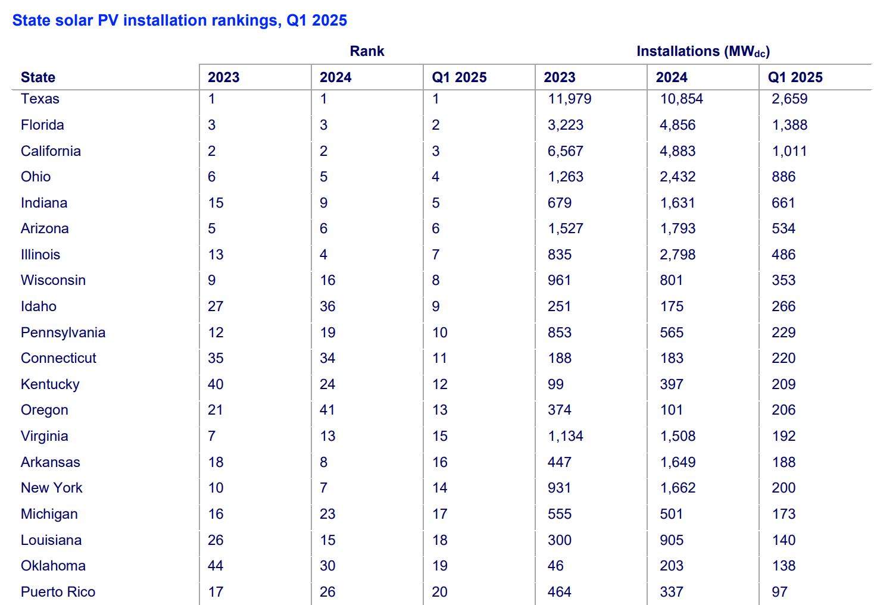
Solar Energy Installations – Where?
Source: U.S. Energy Information Administration & Wood Mackenzie
Notes:
PV = Photovoltaic
Where have solar projects been most common? Where the sun shines!
How have they had such a fast influence? Money talks! I am aware of projects that are soliciting acres at $2-3000/acre per year.
A lot of people lump solar and wind into the same bucket. And, maybe they are related as “clean energy” sources.
But, in contrast to wind turbines, these solar farm completely change use of the property, whereas the wind turbines have a very small/fractional acre footprint.
Given weaker commodity prices in today’s marketplace, do you think we’re more likely to see more solar projects in the coming years? (I think it may be likely.)

Slide 34
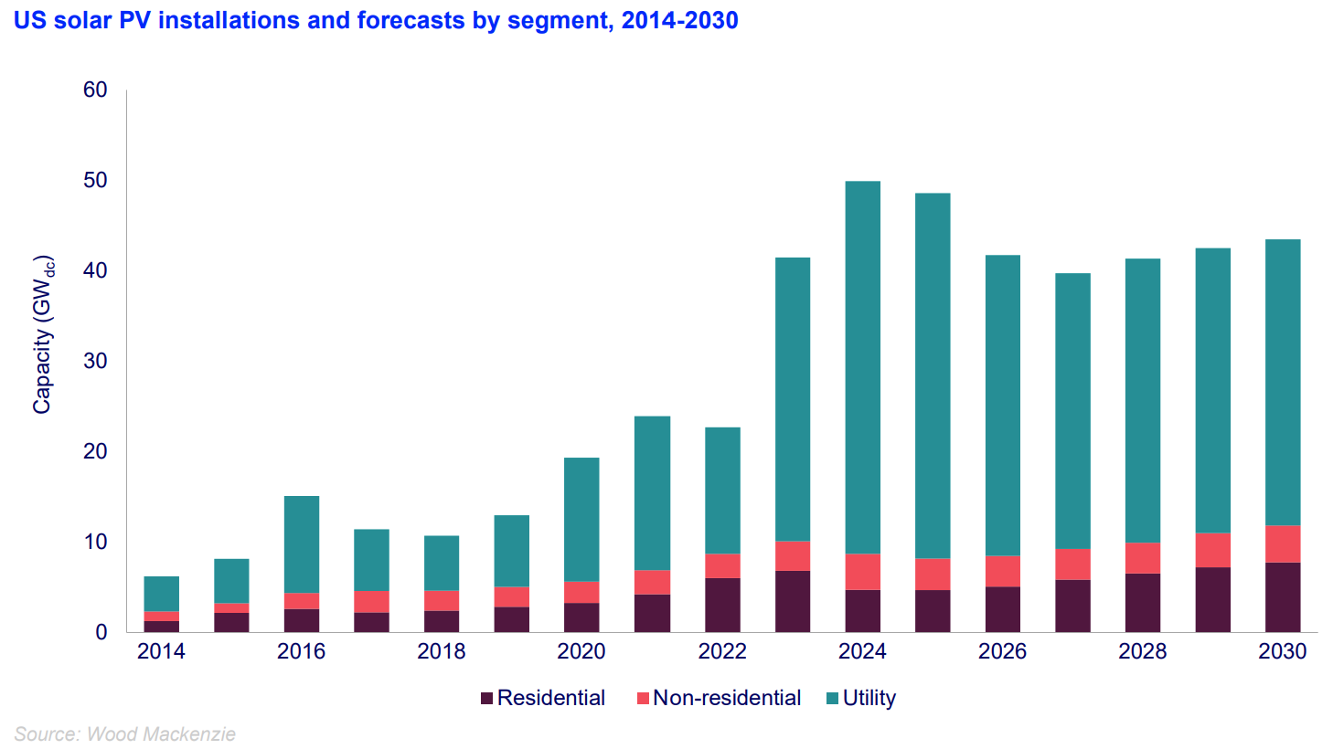
Solar Energy Installations by Segment
Source: U.S. Energy Information Administration & Wood Mackenzie
Notes:
Huge utility scale projects are employing solar with the most impact. Yes, some residential and commercial applications are in play. However, the Utility scale projects that cover several thousand acres of land are the needle-movers.
You can see these utility scale projects between Phoenix and Los Angelos… near Boulder City, Nevada…
AND in northwest Indiana (Mammoth 12,000 acres)…
AND in central Illinois (Double Black Diamond 4,100 acres in Sangamon & Morgan Co’s)…
AND in west-central Illinois (South Fulton Solar 3,800 acres in Fulton Co).
These projects are huge, and they are changing the look of those areas where they are occurring.

Slide 35
What’s driving the Land market?
-Interest rates
Midwest Farmland Values
Notes:
So, crop revenues, commodity prices, and government payments, and other revenue sources, are naturally big drivers underlying farmland values.
Another important influence in our current land market is the cost of capital through interest rates.

Slide 36
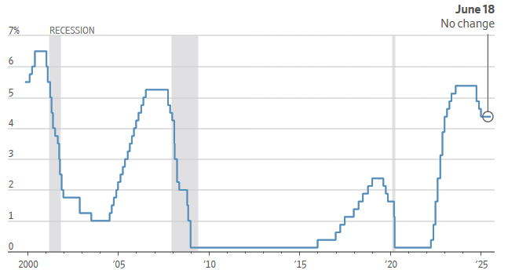
Interest Rates – Federal Funds Rate
Fed Funds Rate (Noun) – the interest rate at which commercial banks borrow and lend their excess reserves overnight. This rate is set by the Federal Open Market Committee (FOMC, “the Fed”).
– Rate used to influence Monetary Policy… 12 Regional Fed Banks meet 8x annually.
– Directly affects consumer loans and credit cards.
– Currently 4.33%
Source: Wall Street Journal, June 18, 2025
Notes:
I think most of you know about the Fed Reserve and their work on interest rates.
The interest rate the Fed controls is called the Federal Funds Rate. This is the shortest of short-term interest rates… and it is what banks are charged by or earn from the Fed in the overnight lending market.
This is kindof the base interest rate, and it has influence over other short-term interest rates. You’ll see changes in the Fed Funds rate impact what you are charged as a consumer on car loans and credit cards, for example.
For perspective, the Fed had increased rates beginning in 2022 and running through the mid-late 2023 to 5.33%, which was its highest point in 15-20 years.
But in late 2024, thinking they had inflation tamed, the Fed started to lower the FFR with 3 different rate moves throughout the 2nd half of 2024. Today, the FFR is currently at 4.33%, which is one full % point lower than a year ago this time.

Slide 37
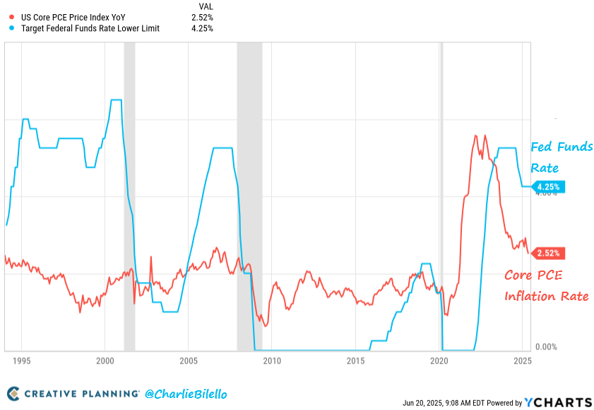
Why Higher Mortgage Interest Rates?
Source: Creative Planning, June 2025
Notes:
Why did the Fed aggressively raise rates in 2022, to begin with?
Because inflation had increased to levels that were well beyond the desired 2% inflation bogey that the Fed has established as its desired target inflation level. In fact, during 2021 and 2022, inflation had increased to 40-year highs. So, one of the policy moves the Fed can use to tame inflation is to raise the FFR, which has the impact of diminishing continued spending and investment in an otherwise overheated economy.
Well, that policy started to work and throughout 2023 and into early 2024, inflation levels did come down. But not yet all the way down to their target of 2%.
[The Core CPI is the price measured basket of goods and services that excludes the most volatile prices, chiefly food and energy. I’m not sure why those are excluded because they seem like pretty significant spending categories to me, but they are excluded.]

Slide 38
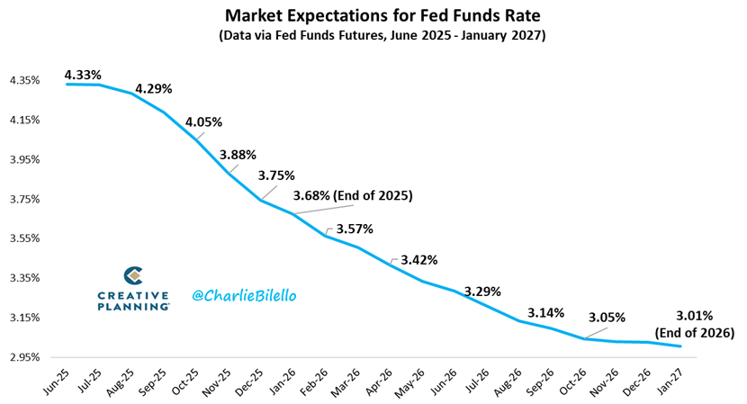
Which Way for Fed Funds Rate in Future?
Source: Creative Planning, July 2025
Notes:
The market is forecasting 3 additional rate cuts in the FFR for the balance of 2025.
And there’s real attention given to how much further the Fed might plan to lower rates… and when. One year ago, expectations were for the Fed Funds rate to be much lower than it currently is. But, again, inflation has proven more stubborn than expected.
And with the spring tariff announcement, there has been pretty broad belief that tariffs could be inflationary. How many of you believe the tariff situation is likely to be inflationary?
Time will tell. I personally expect rates to stay higher for longer, especially given our current policy environment.

Slide 39
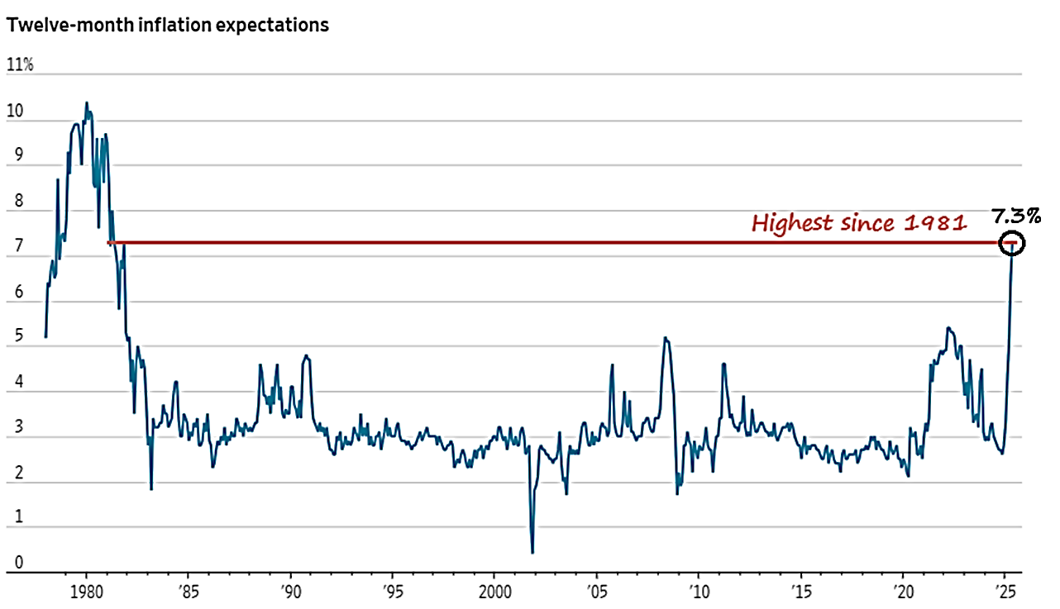
Which Way for Fed Funds? What’s Going to Happen with Inflation?
Source: University of Michigan, Consumer Price Expectations Survey, May 2025
Notes:
The University of Michigan conducts a monthly Consumer Expectations survey, and broadly speaking, the May 2025 survey showed inflation expectations for the next 12 months jumped because those surveyed expect for tariffs to be inflationary.
Again, time will tell.
But one of the Fed’s main mandates is to keep inflation in check. So, they’ve been slow to lower rates thus far in 2025 for concern of potential inflation heating up again because of the tariffs. Talk about a tug of war!
(Fed mandate #1 – Inflation ~2% Annually)
(Fed mandate #2 – Maintain “Full Employment” in our economy).

Slide 40
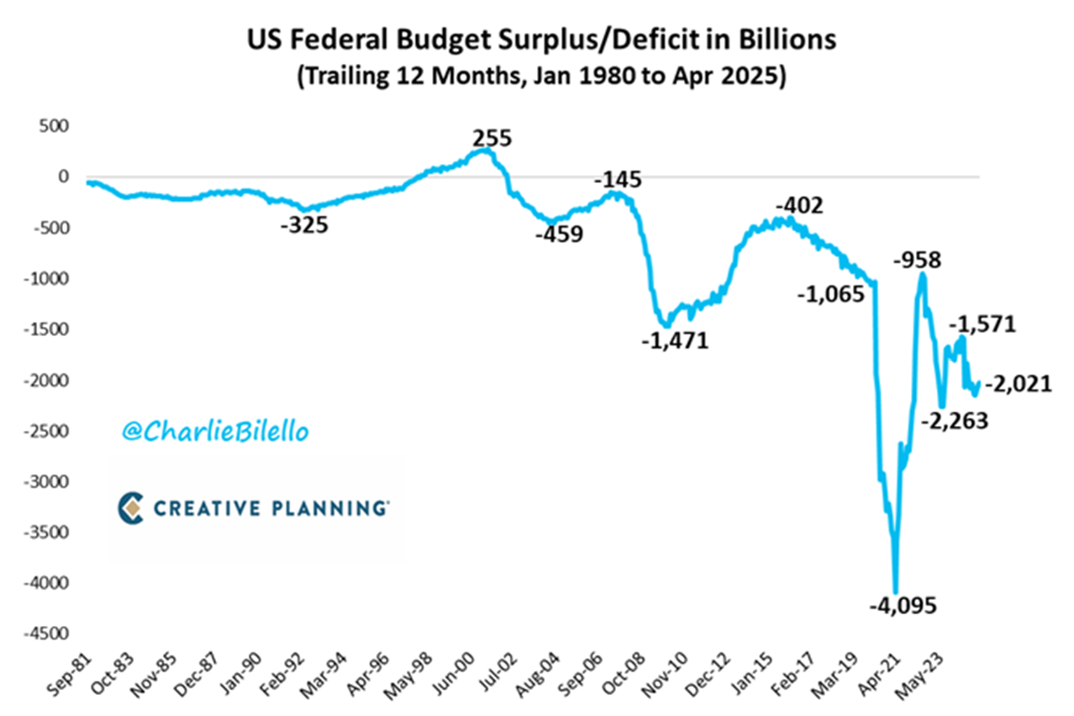
U.S. Federal Gov’t – Budget Deficit
Source: Creative Planning, June 2025
Notes:
Something that the Fed governors, every politician in our country, every bond market trader, and probably most of you, pay attention to and are concerned about is the level of deficit spending by the Federal Government.
Why do I bring this up in the interest rate discussion? Because our deficit and debt spending has to be paid back! And if our total Federal debt gets to a level that the bond market considers “out of hand”, the bond market (which finances our debt) will require higher interest rates in order for bond buyers to buy bonds.

Slide 41
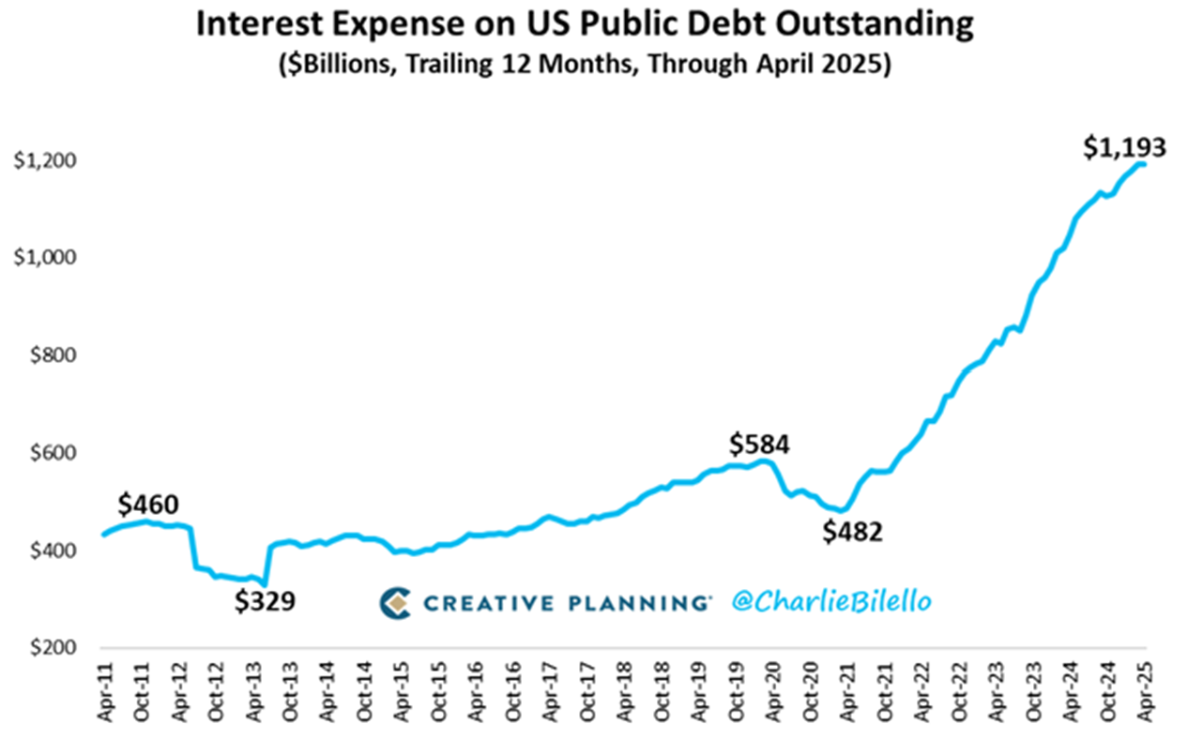
U.S. Federal Gov’t – Interest Expense
Source: Creative Planning, June 2025
Notes:
And as it happens, this is where our annual interest expense is currently at.
How many of you are concerned with our debt and spending?
In a $6 to $7 trillion dollar spending plan, a significant portion of which is deficit spending, this interest expense is increasingly concerning.
For we all know that debt interest payments are dollars that cannot be used for our real priorities. But we’ve become so accustomed to having no fiscal discipline.
To me, this is concerning.

Slide 42
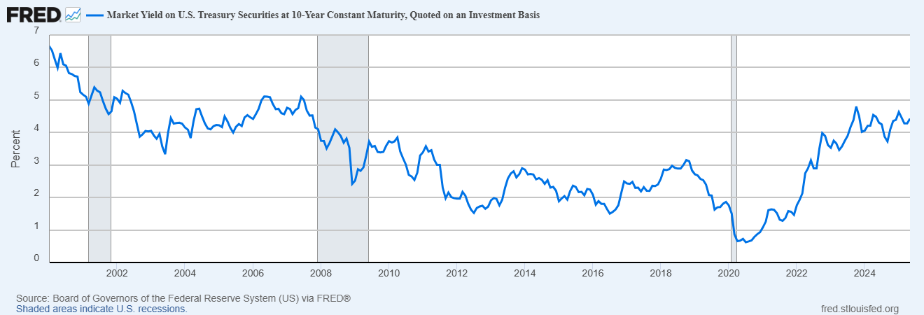
Interest Rates – Long Term View
10-Year Treasury
10-Year Treasury – The 10-Year Treasury is the benchmark used to decide mortgage rates across the U.S. and is the most liquid and widely traded bond in the world.
– Currently trading at or near highest level in 15-20 years, thereby making long-term commercial interest rates near the highest we’ve seen in that time.
Source: St. Louis Federal Reserve Bank
Notes:
This is concerning to me because, if we don’t get our fiscal house in order, all this debt spending and debt accumulation, will impact long-term mortgage rates.
As I have shared before, the 10-Year Treasury bond market is the benchmark rate for mortgage products… and farm mortgages are generally priced at 3-4% higher than the 10-Year Treasury.
So, if the 10-Year Treasury is at 4%, you’ll see long terms mortgage rates in the range of 7 to 8%. And that’s where we currently sit.

Slide 43
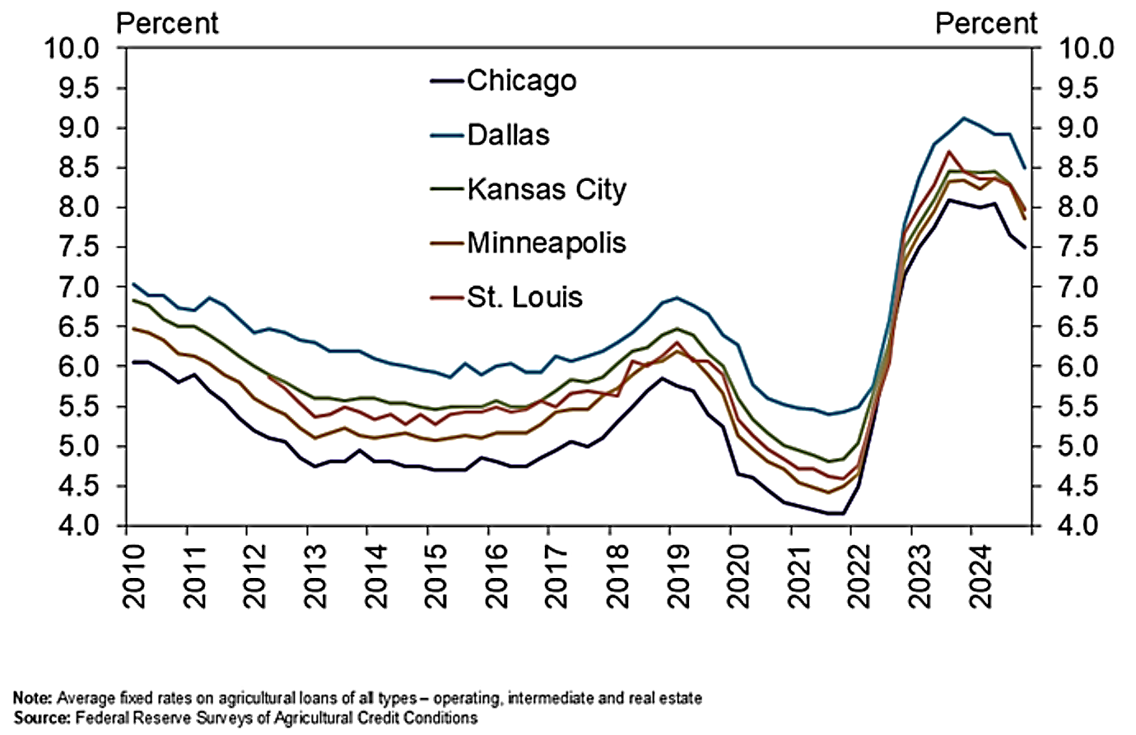
Ag Interest Rates… Long-Term
Source: KC Federal Reserve, March 2025
Notes:
As we look back at a longer-term chart over the past decade-and-a-half of agricultural interest rates, here’s how the average fixed interest rate picture looks for the different Fed Bank regions across the country, as of Q1 2025…
In the next update from the KC Fed of this chart, and once the early 2025 rate data is included, I think we may actually see the trailing 12-month interest rate averages start to creep higher again.
Higher interest rates… in this tug of war environment… are they supportive to land values or harmful to higher land values?
Just remember… If long-term bond buyers require higher rates of return in order to be incentivized to buy our bonds – to cover their increasing risk – it will be more expensive for anyone who borrows money. Maybe to the point of being cost prohibitive… and/or where asset values may be negatively impacted.

Slide 44
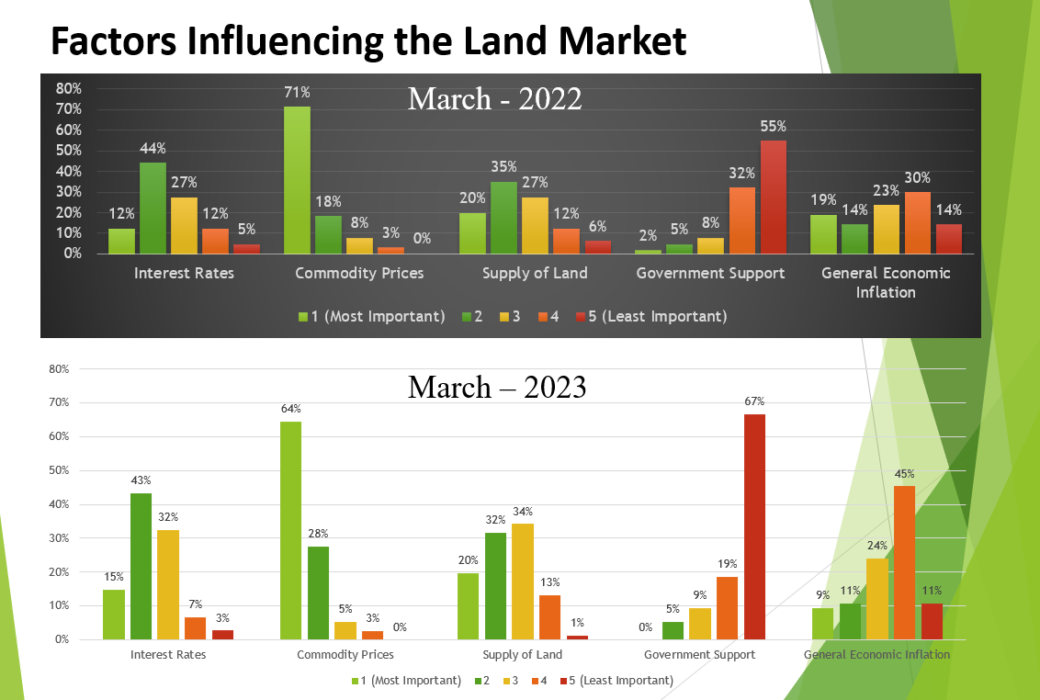
What’s driving the market?
-SUPPLY of land
Midwest Farmland Values
Notes:
The last major factor that I think influences the price of Midwestern farmland is the amount of land that’s on the market at any one time or in any one area.
Normally, when there’s a big supply of something to buy, what happens to the cost of that something?
Or, if something is scarce but a lot of people still want it, what happens to the price?

Slide 45
Land Sale Volume –
Iowa Farmland Market Sales
Source: Farm Credit Services of America
Notes:
Let’s look at sale volume from recent years…
This chart shows data on Iowa only from FCSA, using the 3 filters of…
85% tillable (eliminates many sales),
B) > 80 acres (eliminates many more sales), and
C) Highest and Best Use of Ag.
In 2024, we saw 672 auction sales qualified out of 1200 total auctions. If we were to look into 2024 sale volumes in Illinois, Minnesota, Nebraska, and other areas, I’m very confident we’d see a similar trend. And the trend is what is most important here.
By and large over the past few years, the market has swallowed a huge volume of land without much trouble, and actually did it at much higher prices.
In 2024, I believe we saw demand for additional land shrink for the first time in several years because less income, higher interest rates, and just more overall pressure in the market. BUT… it seems supply of land available to purchase shrunk in a similar way to demand… therefore we did not see an abundance of price movement beyond those moves we already discussed.
It’s always important to recognize and understand basic economics. If demand should fall relative to supply, we may see prices soften more than they have the past year.

Slide 46
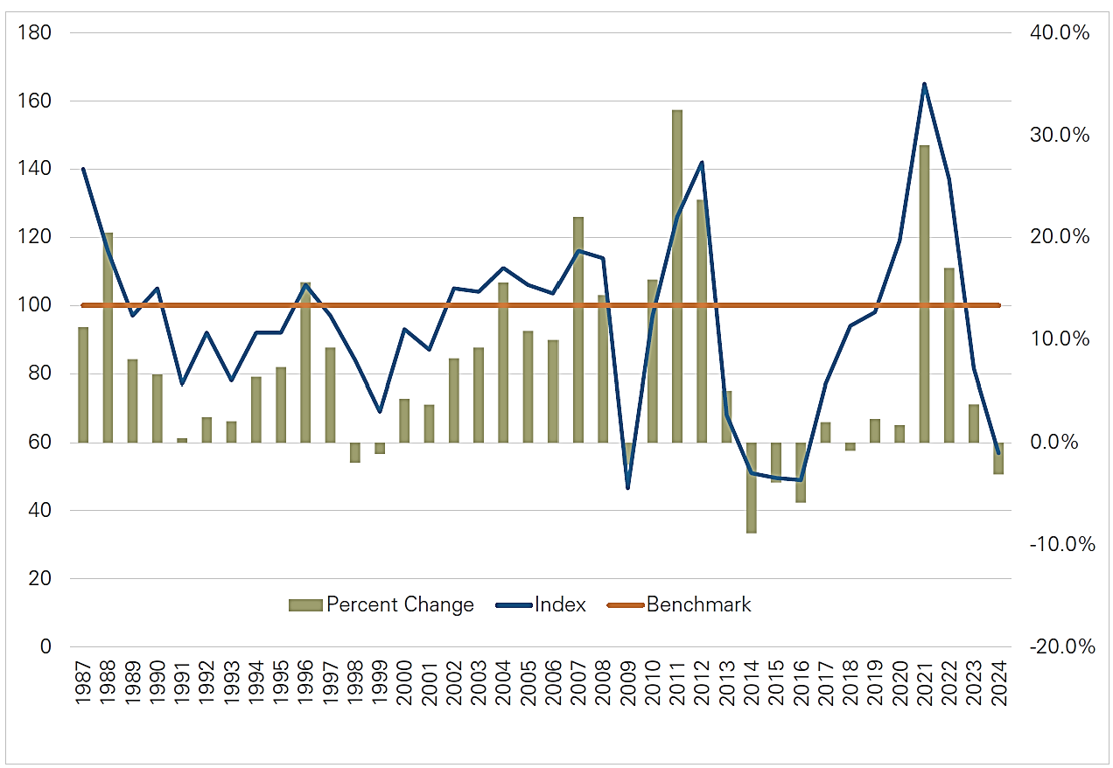
Land Sale Volume in Different Markets
Index of Sale Volume – Blue Line
Farmland Appreciation or Depreciation % - Green Bars
Source: ISU Land Values Survey, December 2024
Notes:
This chart is from Iowa State’s land values survey at the end of 2024. It shows the relationship between strength in land values and the volume of sales. I’ve showed you a similar chart from the KC Fed before.
This basically shows that more land comes to the market when land values are strong – and less land is offered to the market when land values are weak or weakening.
Essentially, this shows us that less land is sold into a weak market. And because less land is sold, that more limited supply does actually has the impact of helping to maintain land price levels.

Slide 47

Who buys & Owns FARMLAND?
Midwest Farmland Values
Notes:
We are nearing the home stretch here, and let’s spend just a few minutes talking about who is buying land…

Slide 48
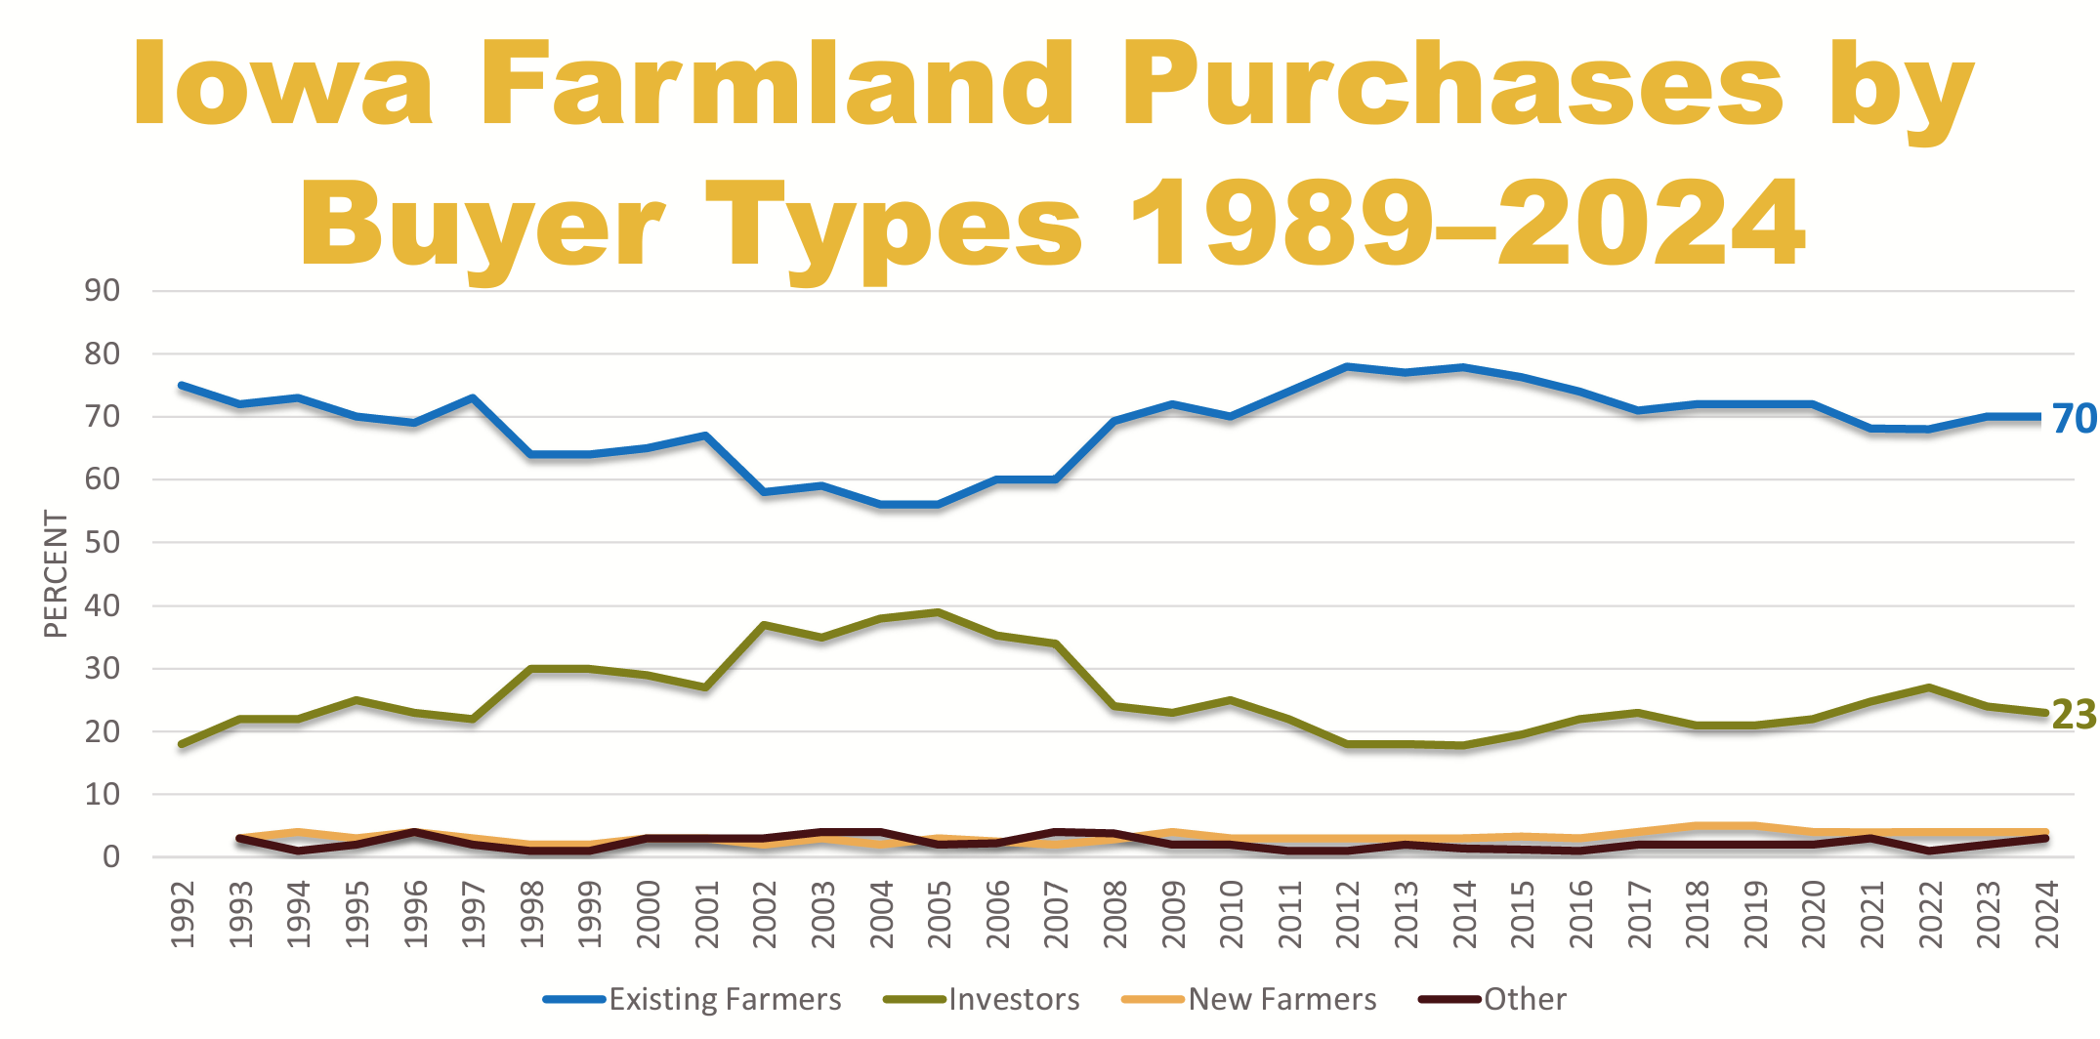
Who Are The Buyers?
Source: ISU Land Values Survey, December 2024
Notes:
From Iowa State University, looking back over the past 30+ years, we find that farmers have made up 60 to 80% of the buying public for farms, depending on the year, and Investors make up 10 to 30% of the buying market for farmland. Most recently, it’s been 70/25/5, with the 5 as new farmers and/or others.
That’s not surprising to most of us. Land is the most essential input for the farming profession so you would expect farmers to be a majority buyer of the core asset.

Slide 49
84%
Source: ISU Land Values Survey, December 2023
Notes:
A popular number from Iowa State is 84%. Anyone know what this 84% reference is all about?
This is the % of Iowa farmland that is owned without a mortgage, according to the most recent Iowa farmland ownership study from Iowa State University.

Slide 50
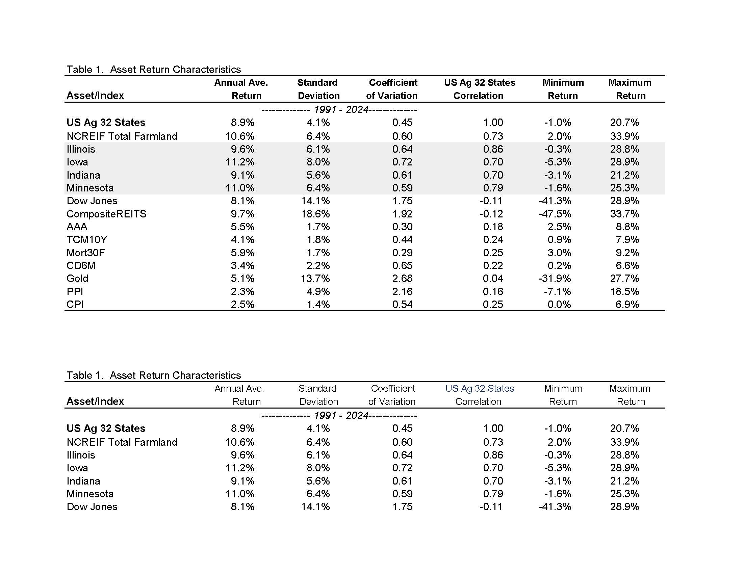
Farmland: Financial Performance 1991-2024
Source: University of Illinois, TIAA
Center for Farmland Research
Notes:
Let’s shift gears a little again and looks at historical farmland returns, across several Midwestern States, as well as some other asset classes.
Over the past 35+ years, farmland has proven to be a very consistent winner above most other asset classes. And if I showed you a 40 or a 50-year chart, farmland generally the winner there, as well.
Longer term charts show slightly better stock performance than the past 35 years… but stocks still do not out-perform farmland.
And maybe the biggest difference in asset performance is how farmland fares when things in ag get tough. Take a look at the minimum/maximum return columns of the various assets… stocks have sailed high, but stock values have also collapsed at certain times. Farmland, in contrast, has also had times with its sails out… but has not had the more violent ride of other assets during the stormy seasons.
Said differently, how much did farmland values change this spring with the tariff announcements, compared to the S & P 500? Volatility in land is generally much lower.

Slide 51
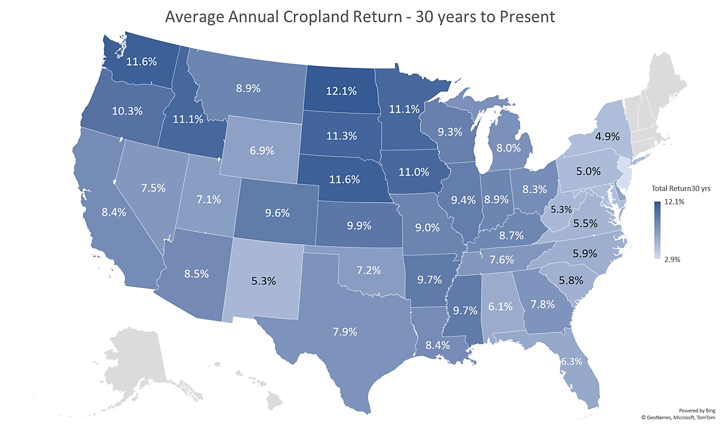
Farmland: Financial Performance 1994-2024
Source: University of Illinois TIAA Center for Farmland Research & USDA
Notes:
Here’s a little different look to even more state-level data than provided in the chart on the last slide. These are average annual returns to row-crop farmland over the past 30 years.
Pretty impressive returns across the Corn Belt and central Plains.

Slide 52
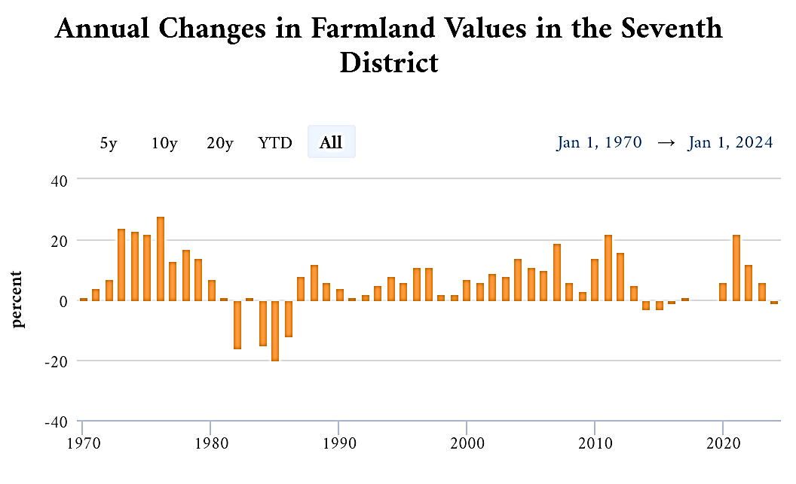
Farmland: Financial Performance
Source: Chicago Fed, June 2025
Notes:
Here’s another representation of Midwest farmland as an asset class going back to January 1970… 55 years of data. This chart is from the Chicago Fed, and each of the bars reflects year-over-year asset value appreciation or depreciation.
Out of these 55 years, there’s only been 8 years when values have fallen, along with 2 flat years. The other 45 years have had some level of year-over-year appreciation. And the significance of the up moves have been much more significant than the down years. In fact, 18 of the 55 years had more than 10% annual appreciation.
And when you consider that this is only appreciation or depreciation of the asset – e.g., does not include the annual income from the asset – I think that is impressive.
Said differently… farmland is not a sure bet… but over the long term, it has been an incredibly performing investment.
Let me ask… Does anyone here wish they would have bought more land 30 years ago?
Or, is there an asset class you would have rather invested your money in?

Slide 53
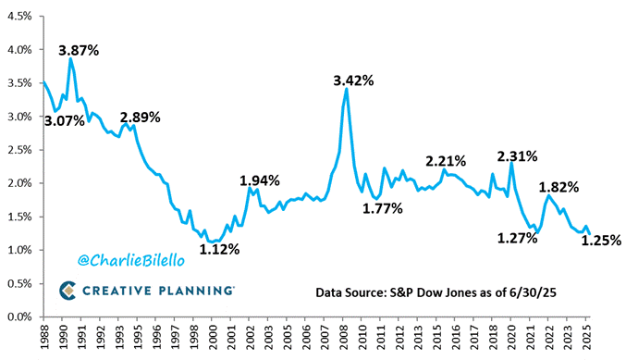
S & P 500: Dividend Yield
Trailing 12 Months
Source: Creative Planning, July 2025 Update
Notes:
Now when I talk to potential investors, many say the annual returns to farmland just aren’t high enough compared to equities and other possibilities. But when we look at the data, that’s not always true.
Here’s a chart detailing the historical dividend yield on the S & P 500. At the end of Q2 here in 2025, the index yielded 1.25% for the past 12 months… it’s lowest level since 2000. Let me ask this group… What is a dividend yield?
Correct, it’s the income produced by an asset and returned to the owner divided by the asset’s value.
Let’s do a little thought exercise… If we take your farm’s income, and make a comparative calculation by dividing your per acre income over the per acre value of your farm, did you earn a better dividend yield on your farm this past year than you could’ve in the S&P?
The fact of the matter is, over the past 35+ years, row-crop farm dividend yields have generally outperformed that of the S & P 500.
So… my conclusion here… is that farmland overall returns are historically better than stocks… and so are the income portion of those returns. Does this surprise anyone here?

Slide 54

What to expect in the near future?
Midwest Farmland Values
Notes:
Final topic… what to expect in the coming months…

Slide 55
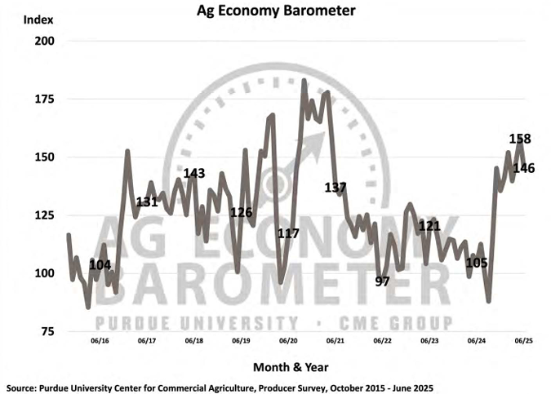
Farmer Attitudes Have Zig-Zagged…
Source: Purdue Ag Economy Barometer, June 2025
Notes:
Something we should talk more about, which I think is important to understand about the farmland market, is that the land market is influenced by farmer attitudes and expectations. So, watching and listening to certain measures of attitudes in the country can be really helpful to better understand market direction.
Purdue University publishes a monthly gauge of 400 surveyed farmers with their sentiments on various topics. And, it’s a survey I watch.
Recent survey results show that farmers attitudes improved since last fall. And that improvement is due exclusively to what they perceive as a more favorable environment politically as it relates to regulation and tax policy, with the change in administrations.
With the tariff situation earlier this spring there was a little zig-zag in that attitude level… but by and large, there was still confidence in agriculture in the ability of the Trump Administration to position US agriculture to be successful.

Slide 56
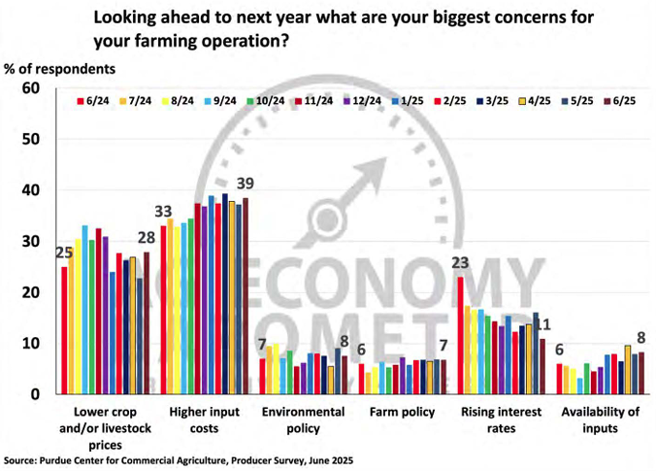
But Farmer Concerns Are More Focused…
Source: Purdue Ag Economy Barometer, June 2025
Notes:
The main farmer concerns for the past year have centered on the margins of production. Basically, farmers as a group continue to be chiefly concerned with high input expenses and low crop and livestock prices.
And that’s not really changed all that much over the past year.

Slide 57
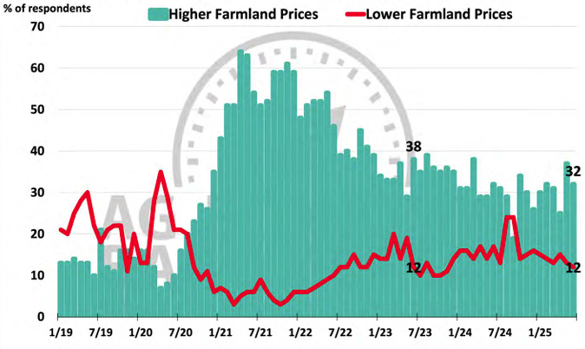
12-Month Expectations for Farmland
Source: Purdue Ag Economy Barometer, June 2025
Notes:
As far as farmland values, farmers’ short-term expectations for where land values will be in a year, have also not really changed much for more than a year.
You can see in 2023 that confidence dropped little by little… but no major movements in the past year except for right before harvest last fall when it stopped raining and people became pretty negative/bearish for a short time.

Slide 58
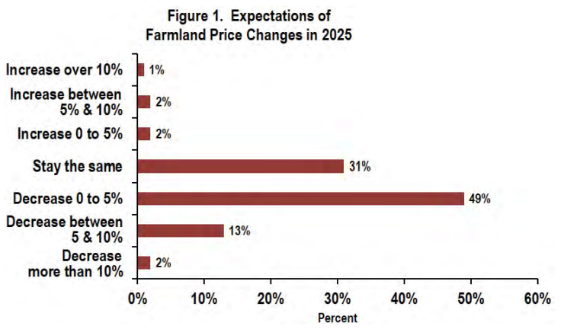
2025 Land Price Expectations in Illinois
Source: ISPFMRA, March 2025
Notes:
Farmland professionals in Illinois were maybe a little more pessimistic than the Purdue survey, with 64% saying land values would fall throughout 2025… while roughly a third thought things were going to be flat.
To be clear, at the time this survey was taken, there was little expectation for higher land values… so this may hit you a little more negatively than it would if the survey were taken today.

Slide 59
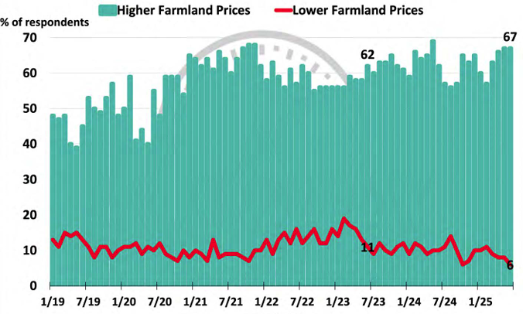
5-Year Expectations for Farmland
Source: Purdue Ag Economy Barometer, June 2025
Notes:
And from the Purdue survey, we see that longer-term farmland price expectations still remain relatively high.
But this is also an interesting graph, because back in 2019 and 2020 when conditions were poor the last time, there was still this general belief in the marketplace that land values would be higher in 5 years than they were at that time. Farmers overall are an optimistic bunch. And that holds true today.
Show of hands… how many here think land values will be higher in 5 years than they are right now? How about 10 years?

Slide 60

What to watch in the coming months…
Commodity Prices
  What happens balance of 2025?
  US Production vs. South America
Interest Rates & Inflation
  Inflation vs. Employment… What’s the Fed’s next move?
  When?
Land Sales Volume
  Slow in early 2025… any pickup coming?
  Demand is down from ‘21-’24, but supply is down comparatively more, thereby maintaining price levels.
  May become “localized” issue.
Notes:
Here’s what I’d be watching for in the coming months to keep getting clues…
REVIEW THE BULLETS

Slide 61

What to watch in the coming months…
Farm Policy Under Trump
  New Farm Bill in 2025?
  Crop Insurance protected and/or expanded?
Tax Policy Under Trump
  The Big Beautiful Bill
  Impact for Income & Capital Gains tax rates, Step-up in Basis, 1031’s
  Estate Taxes
Tariffs, Free Trade under Trump
  Is there any new clarity?
Notes:
REVIEW THE BULLETS

Slide 62





www.Hertz.ag
  Farmland for Sale
  Auctions and Auction Results
  Ag Links
  Request Weekly Farmland Email

