Slide 1

Professional Services for Farmland Owners and Investors:
Professional Farm Management
Farmland Sales & Acquisitions
Farmland Auctions
Trusted Farmland Appraisals

Slide 2

Landowner Educational Seminar
Summer 2025
Farm Lease Trends/
Leasing Alternatives

Slide 3

Purpose of a Lease
To define and document the split of income, expenses, and responsibilities of farm owner and farm operator
Notes:
To document what was agreed to.

Slide 4
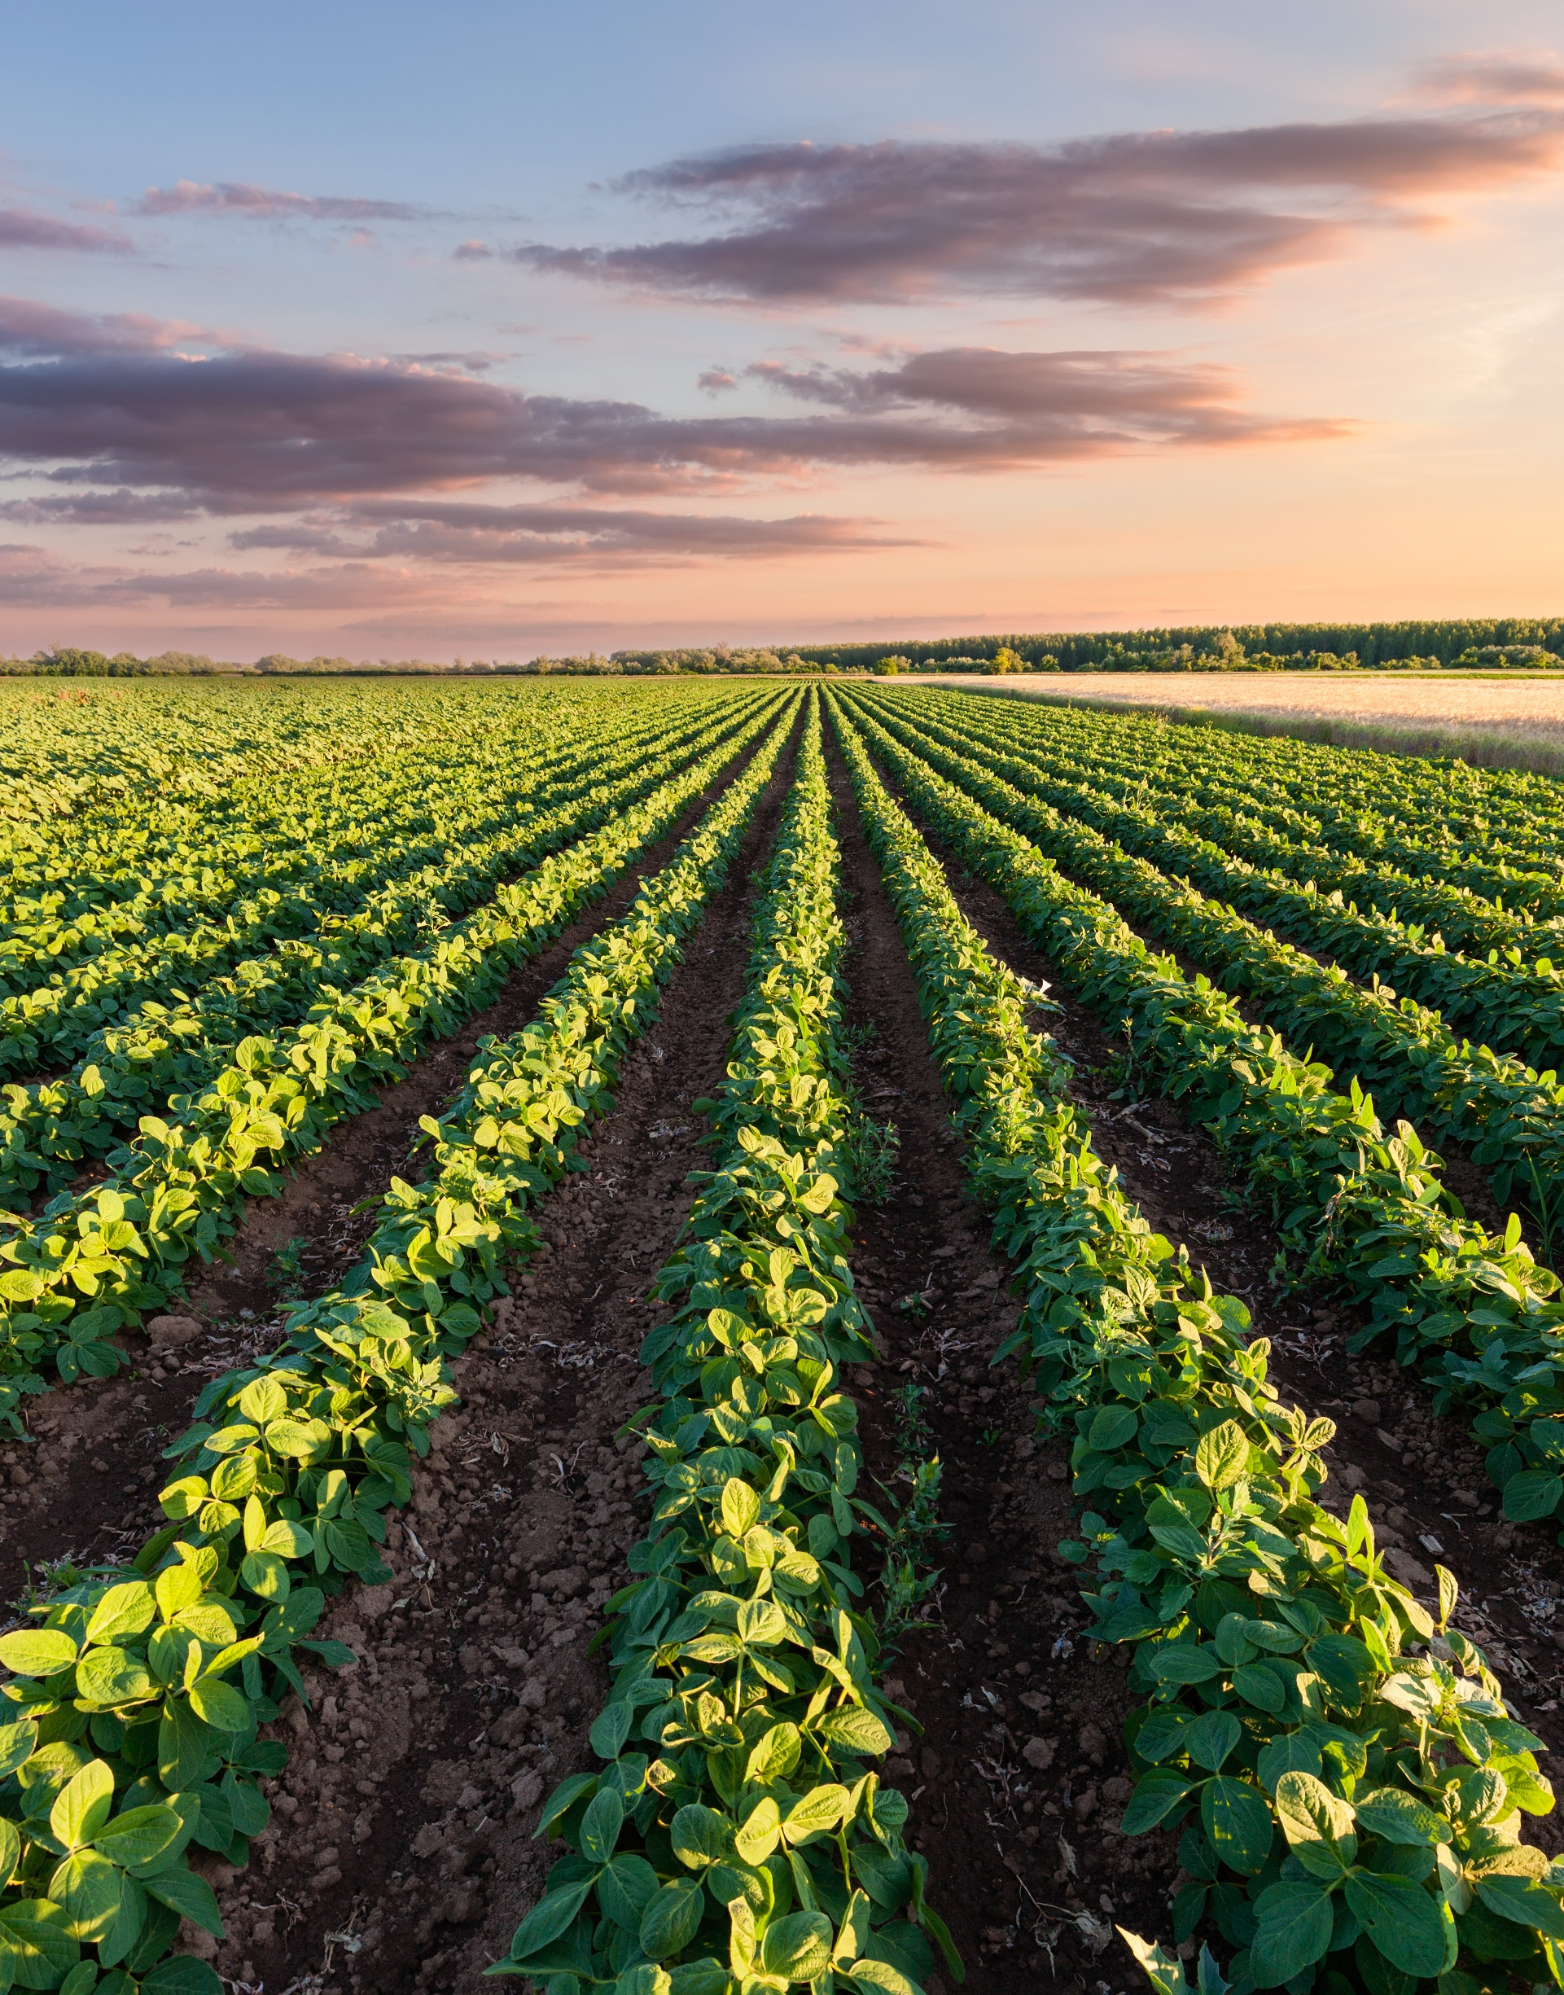
Expression of Expectations
🌾Appearance
🚜 Access
🔧Maintenance
💧Chemical Practices
🌱Conservation
📜CRP/CSP

Slide 5
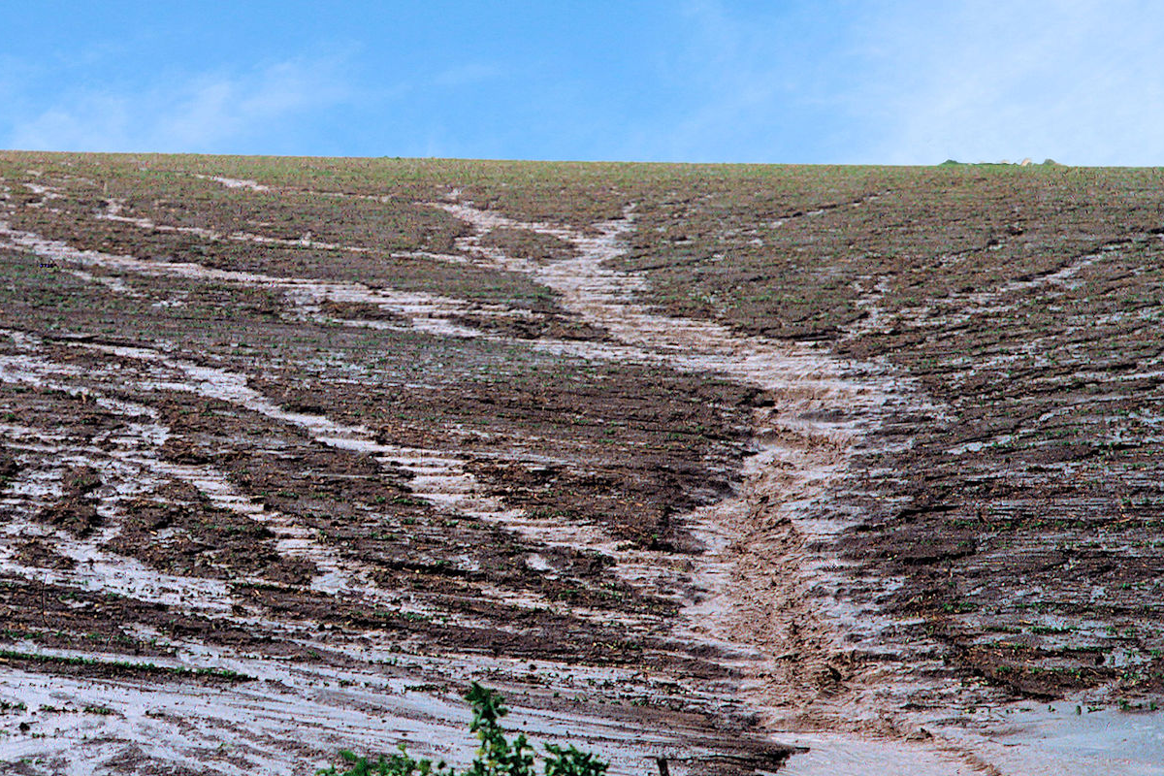
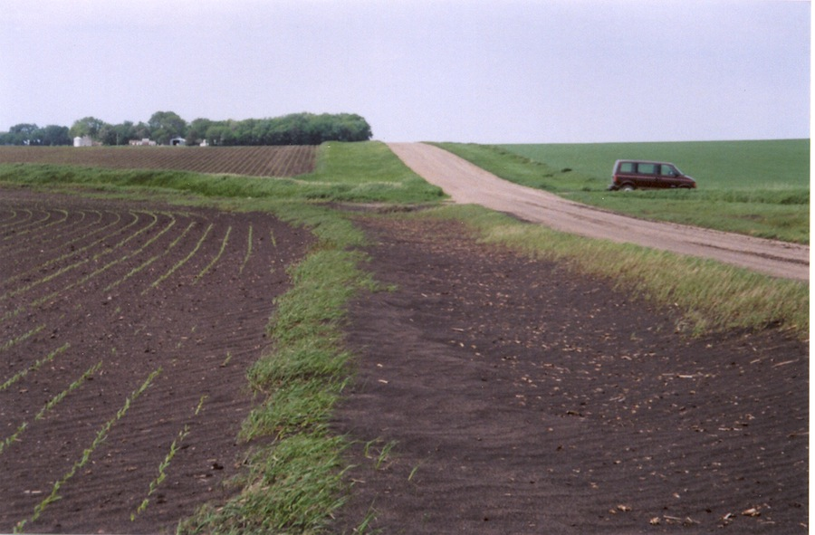
Erosion
Caused by Water
Caused by Wind

Slide 6
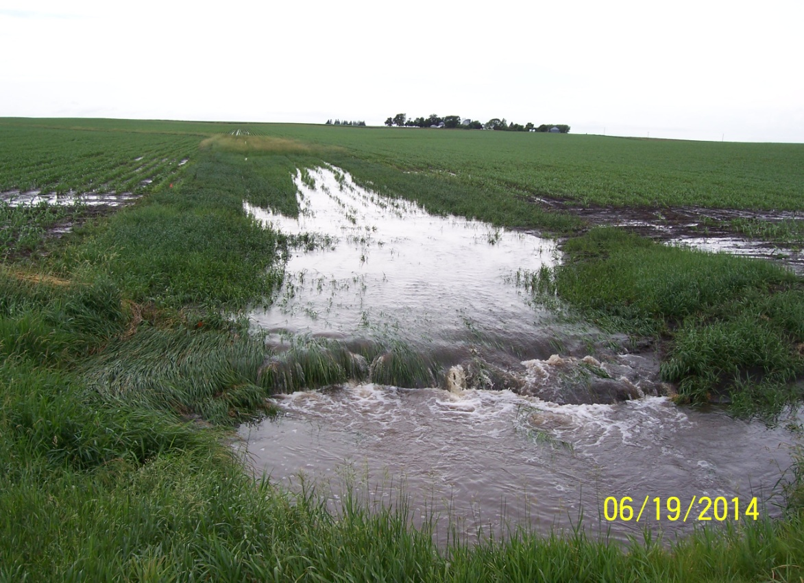
Waterways
Notes:
Maintain waterways to reduce soil loss and give water a way off the farm
KJ still working on alternative slide

Slide 7
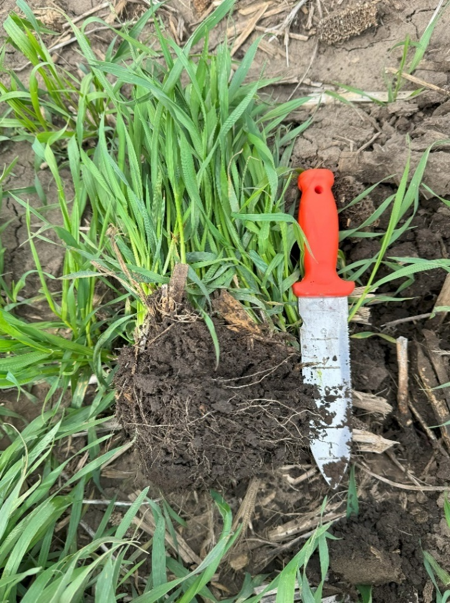
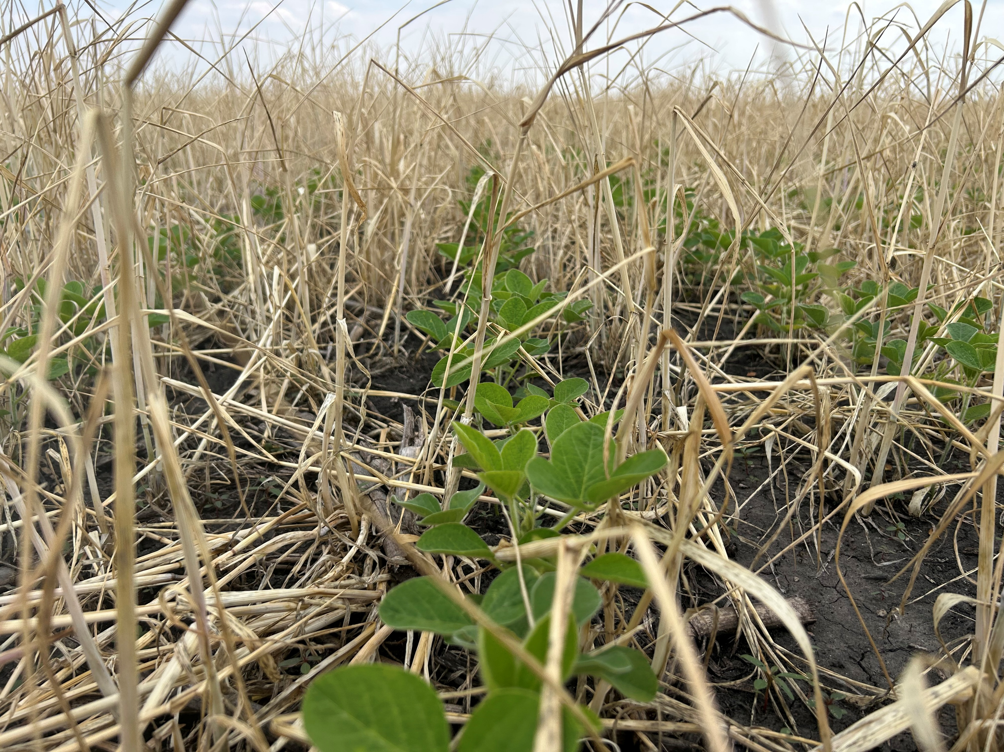
Cover Crops
Who Should Pay the Cost?
Who Receives the Benefits?
Notes:
Cover crop photo updated

Slide 8
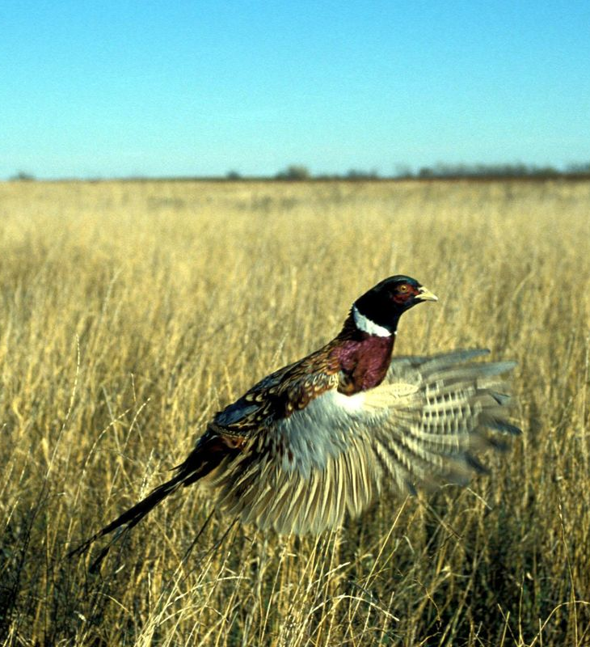
CRP/CSP
Conservation reserve
Conservation stewardship
Transferability of contracts and income
Who is receiving the payments?
Who is responsible for maintenance?
Hunting rights
Notes:
Kayse will format photo- Done KJ I added hunting rights to this slide as farms with CRP having hunting opportunities. Therefore, spell out in the lease if operator has hunting rights or if landowner reserves those.

Slide 9

Expression of Expectations Cont’d:
🧪Fertilizer Balance
🔨Fences
🔧Improvements
📊Information
📋Insurance
♻️Carbon Credits

Slide 10

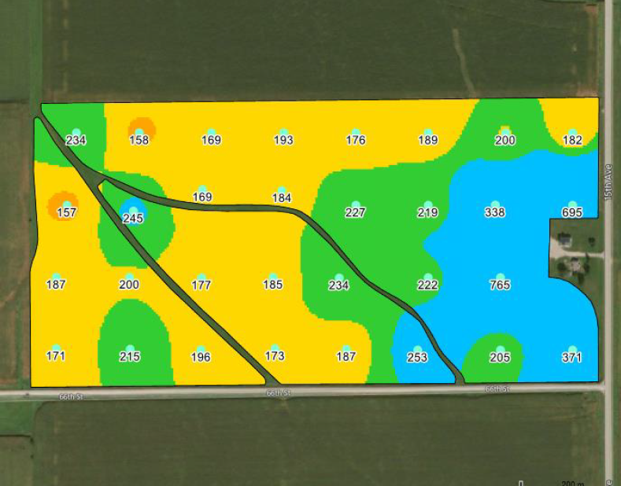
Fertilizer Balance
Soil testing & crop removal rates
Photo courtesy of serc.cartleton.edu

Slide 11
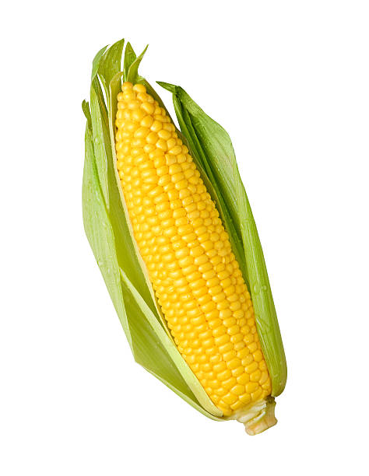

Maintaining Fertility
Nutrients | 60 bu | 80 bu | 200 bu | 275 bu
Phosphorus | 43 | 58 | 70 | 96
Potassium | 72 | 96 | 50 | 69
Operator to maintain PH of 6.2-6.7
Lime will be depleted 25% each year

Slide 12

Communication of Farm Information
Access and ownership of input records, yields, maps, crop insurance guarantees
Notes:
Jake revise

Slide 13
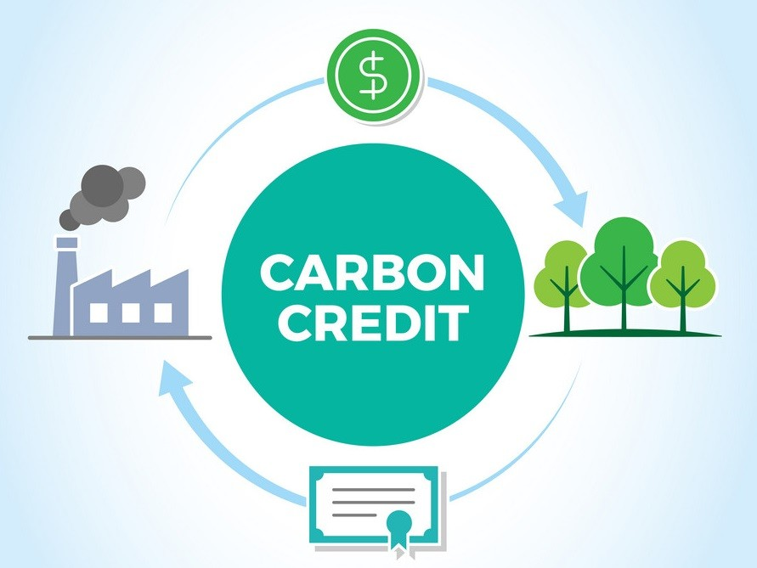
Carbon Credits
Defining in a farm lease?
Image Source: LinkedIn
Notes:
Leases should establish who can sign up for carbon credits and who gets the benefits. Cost vs benefits

Slide 14

Lease Types & Considerations

Slide 15
Factors to Consider
🎯 Owner’s Goals and Objectives
Immediate income and cash flow versus making improvements that will enhance income long-term and market value
Long-Term versus Short-Term Ownership
Will the farm be retained by the next generation?
Conservation
Maintaining family heritage (Buildings)
Notes:
Jake rewrite AI

Slide 16
Multi-Year Leases
Owner Advantages
Owner Disadvantages
Locked in rental rate when market is softening
Tenant longevity
Eliminates the need to negotiate lease terms each year
Inability to make changes if tenant is not performing to your standards
Decline in market value if a farm is sold with a lease in place
Unable to increase rent when the market is appreciating
Less control
One way street

Slide 17
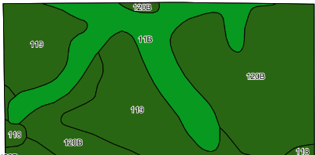
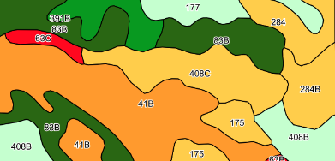
Factors to Consider
🌾Land Quality/Productivity
The higher the quality of the land, and the more improvements the greater advantage to having a share of the crop

Slide 18
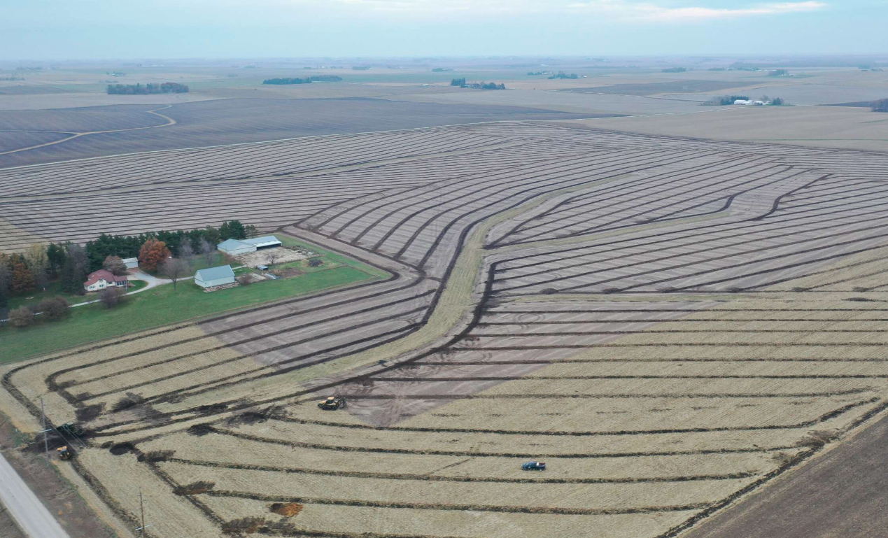
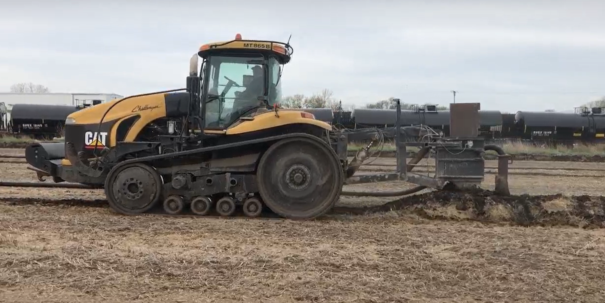
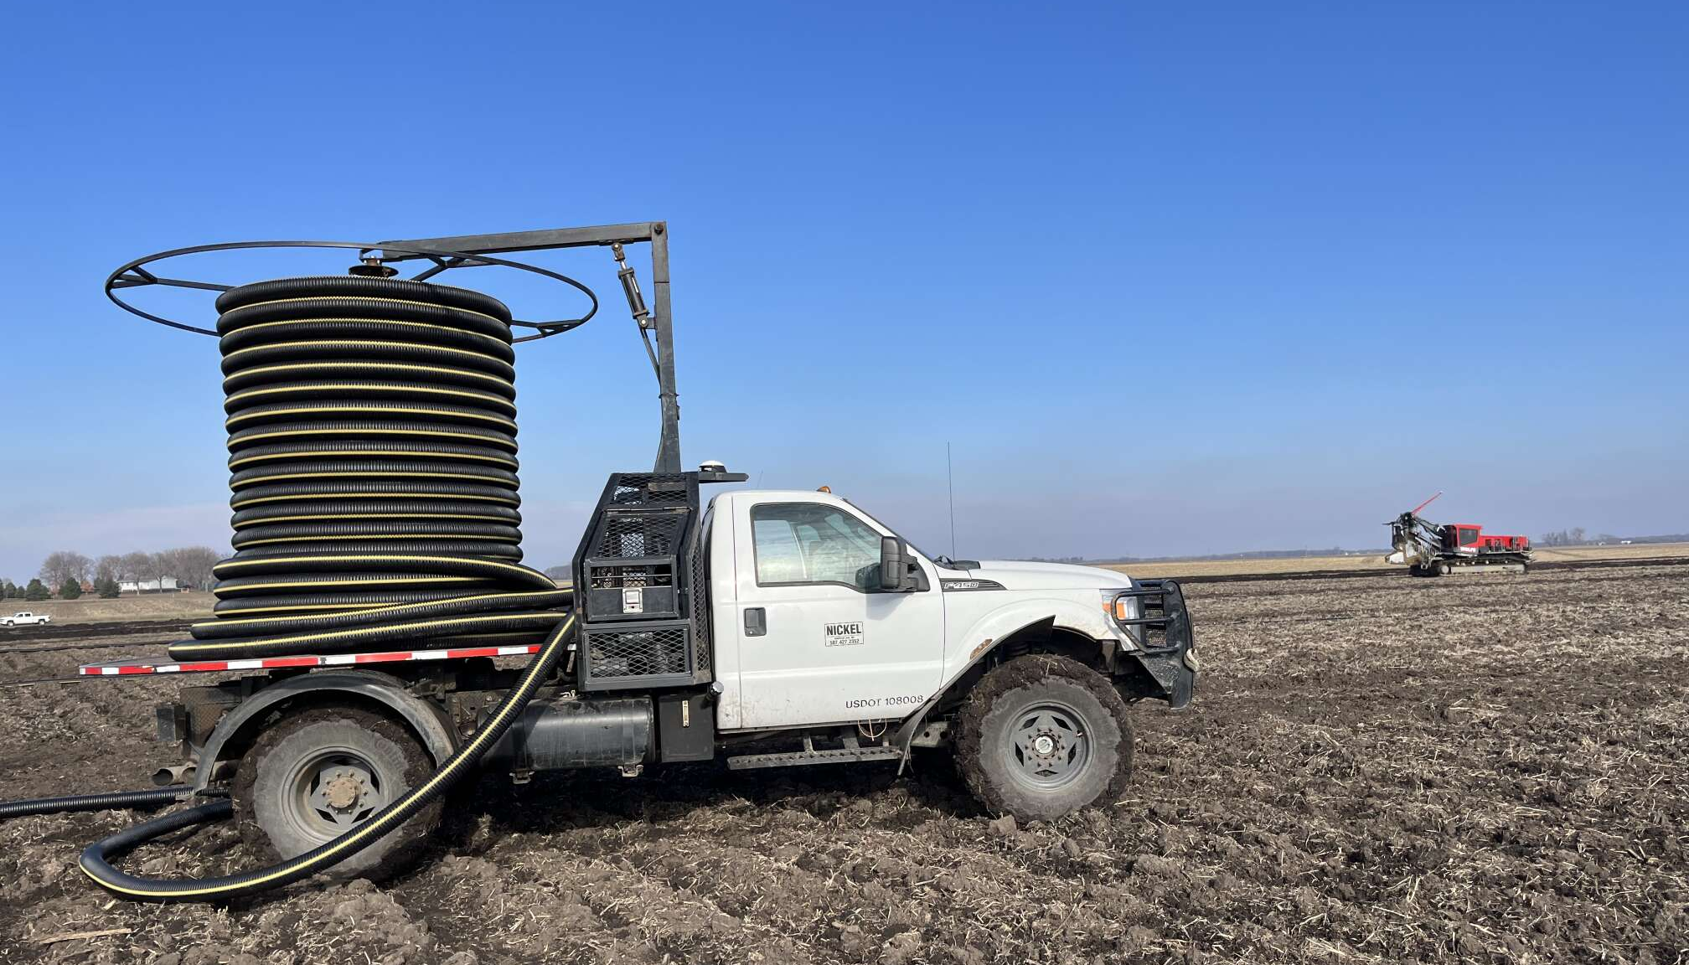
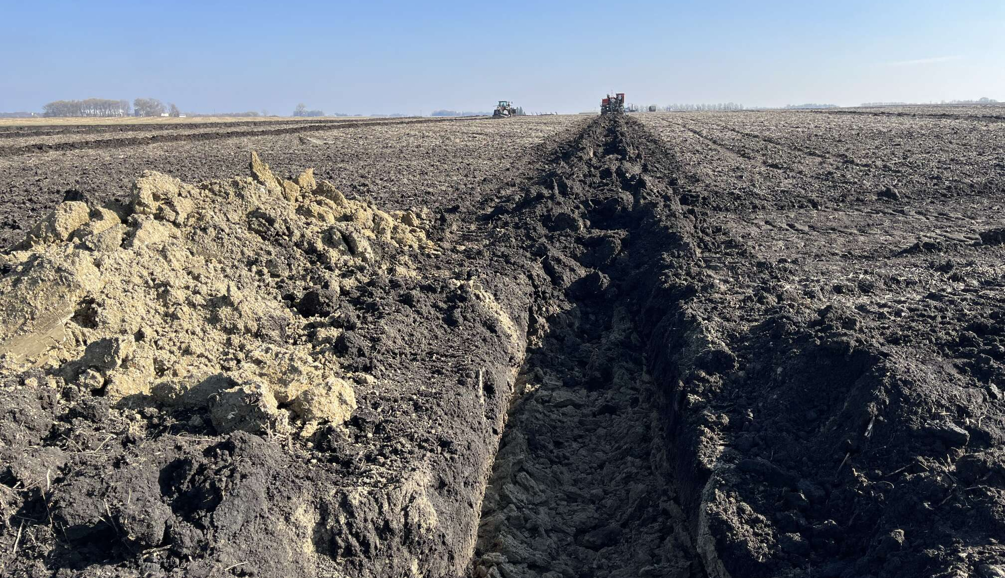
Farm Improvements

Slide 19
Factors to Consider
🧾 Tax Implications Considerations:
§179 Deduction
Immediate expensing of qualified business expenses
§168(k) Bonus Depreciation
Bonus depreciation on qualified assets phasing out – 2025: 40%
  As of July 2025, bonus depreciation underwent significant changes under the One Big Beautiful Bill (OBBB) reinstates 100% bonus depreciation
Social Security Ramification
Estate Tax Ramifications
Considerations for high-net-worth transfers and exemptions
Deductibility of Certain Expenses
Differences between cash rent and participating leases
QBI Deduction (Qualified Business Income)
One Big Beautiful Bill (OBBB) moves the deduction from 20% to 23%
Notes:
Iowa Presenters, comment on Beginning Farmer Tax Credit

Slide 20
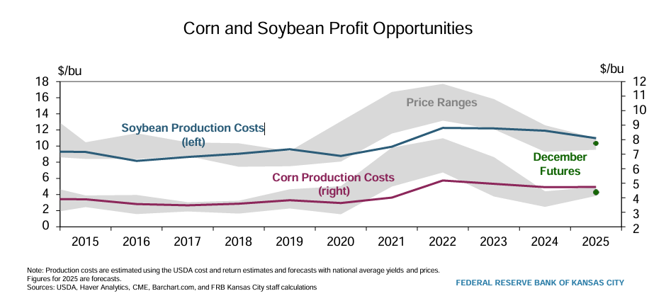
Financial Considerations

Slide 21
Financial Considerations
"Many producers entered the 2024 crop year with strong working capital positions. However, throughout the 2024 and 2025 crop years with lower revenues and increased expenses, they are now experiencing a continued negative impact to their working capital."
– Jason Lage, GNB Bank - Iowa

Slide 22
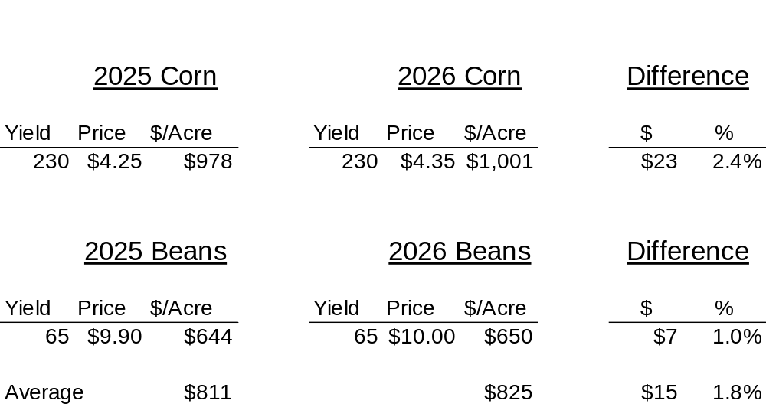

Crop Income
Notes:
Clint updated

Slide 23
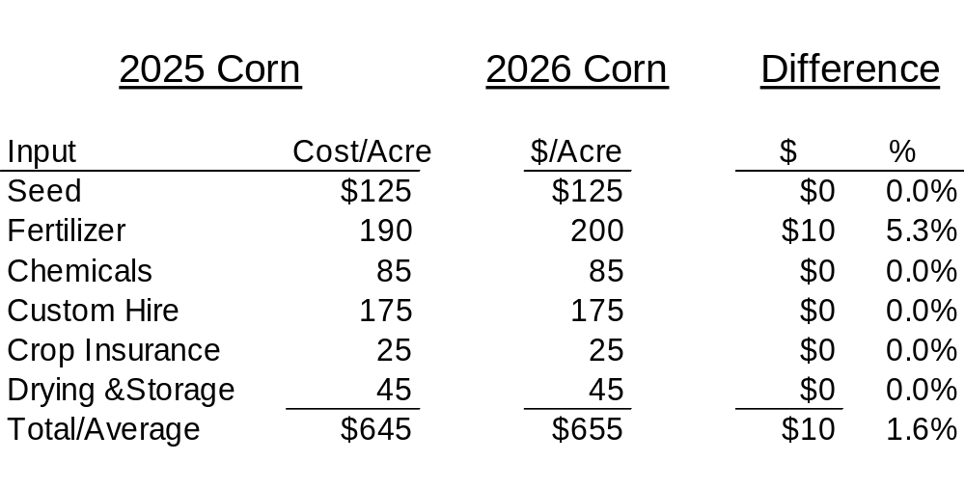
Crop Expenses
Notes:
Clint updated

Slide 24
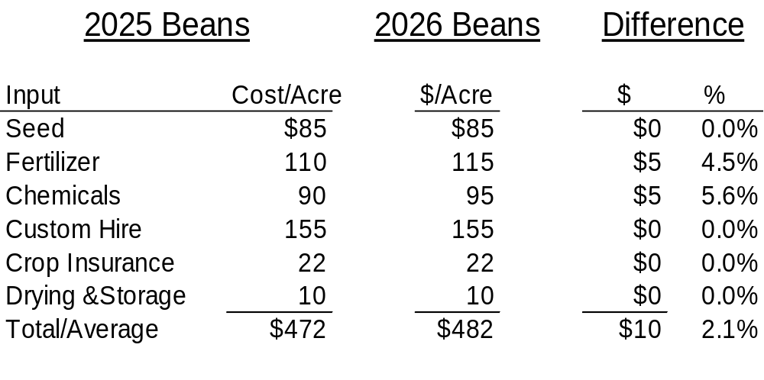

Crop Expenses
Notes:
Clint updated

Slide 25
Revenue & Cost Comparison: 2025 vs 2026
📈 **Revenue per Acre**
• Corn: $978 (2025) ➜ $1,001 (2026) | ↑ $23 (2.4%)
• Beans: $644 (2025) ➜ $650 (2026) | ↑ $7 (1.0%)
• Average Revenue: $811 ➜ $825 | ↑ $15 (1.8%)
💸 **Cost per Acre**
• Corn: $645 ➜ $655 | ↑ $10 (1.6%)
• Beans: $472 ➜ $482 | ↑ $10 (2.1%)
• Average Cost: $559 ➜ $569 | ↑ $10 (1.8%)

Slide 26
Lease Termination Deadlines:
Iowa – September 1st
Illinois – November 1st
Indiana – Oral lease: 3 months prior to end of lease
– Written lease: 3 months prior to end of lease or as specified in the lease
Minnesota – Same as Indiana
Missouri – 60 days prior to end of lease
Nebraska – Oral lease: September 1st
– Written lease: September 1st or as specified in the lease
Wisconsin – October 1st
Notes:
REFORMAT - JAKE

Slide 27
Farm Lease Alternatives
1. Traditional 50/50 Crop Share
2. Variation to 50/50 Crop Share
Operator pays more of the inputs
Operator pays a cash rent in addition to one-half of the inputs

Slide 28

Farm Lease Alternatives
3. Custom Operation
Landowner: 100% of Income and Expenses
Guarantees Landowner control
Owner maximizes return from their land, improvements, and management
Helps large farming operations stay below government payment limitations
Helps young farmers spread costs without more risk

Slide 29
Farm Lease Alternatives
4. Modified Crop Share
Landowner receives a negotiated percentage of the crop and government payments and pays 100% of the seed, fertilizer, and herbicides
Typical range is 75-80% to landowner
Operator receives the balance percentage in return for machinery and labor
Each party pays their respective share of crop insurance, drying, and storage

Slide 30
Farm Lease Alternatives
5. Net Share
Owner receives a specified percentage of crop (usually 30% to 40%)
Farm operator pays all input costs
Owner pays for crop insurance, drying, and storage on owner’s share of crop

Slide 31

Farm Lease Alternatives
6. Cash Rent
Guaranteed Income
Less Control
Lower Risk ? ?
UCC-1
Rent Collection in a Challenging Growing Season
Fertilizer–Requirements
Tax Treatment

Slide 32
Farm Lease Alternatives
UCC-1
Iowa, Minnesota, and Nebraska landowners must file a UCC-1 with the Secretary of State to secure deferred rent payments.
Illinois landowners have a statutory landlord’s lien and are not required to file a UCC-1. However, prospective grain buyers must be notified of the landowner’s lien.

Slide 33

Farm Lease Alternatives
7. Flex/Variable Cash Leases
Cash rent lease with a variable component
Shares risks without actively participating
No “locked-in” rental rate
Landowner can be guaranteed a base rent, plus a potential flex payment
Landowner receives the actual yields on the farm

Slide 34
Types of Flexible Leases
📈 Based on Crop Yield Only
💲 Based on Prices Only
📊 Based on Gross Income (Yield and Price)
🧾 Based on Net Income (Yield and Price minus Inputs)
🛡️ Based on Crop Insurance Parameters

Slide 35
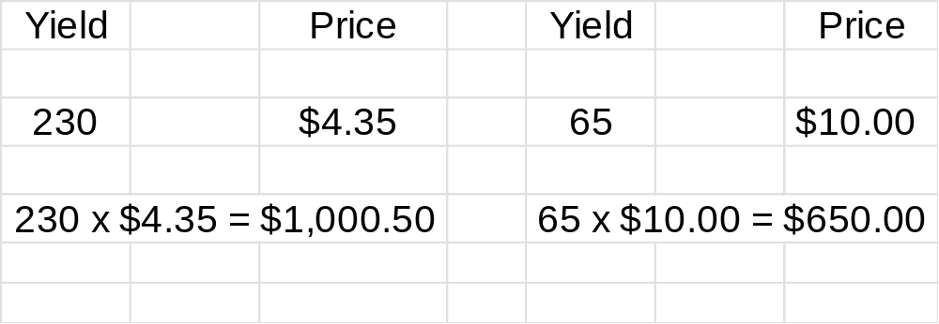
Flex Lease Example
Base Rent $275
Flex = 35% over $930/Acre on Corn
40% over $757/Acre on Soybeans
Notes:
Flex $ per acre trigger is 2025 INPUT COST FROM ABOVE + Base Rent of $275

Slide 36
Flex Lease Example
 | CORN | SOYBEANS
GROSS INCOME: | $ 1000.50 | $ 650.00
PRICE/ACRE: | - $ 930 | - $ 757
TRIGGER INCOME: | $ 70.50 | $ -107.00
 | x 35% | x 40%
BONUS RENT: | $ 24.68 | $ 0
BASE RENT: | + $ 275.00 | + $ 275.00
TOTAL RENT: | $ 299.68 | $ 275.00
Average Rent: $287.34 / acre
Notes:
NO FLEX ON SOYBEANS
SMALER FLEX ON CORN

Slide 37
Flex Lease Example
APH = 210
Spring Price = $4.70
APH x Spring Price x 33% = Rent
210 x $4.70 x 0.33 = $325/Acre

Slide 38

Where Do We Go From Here?

Slide 39
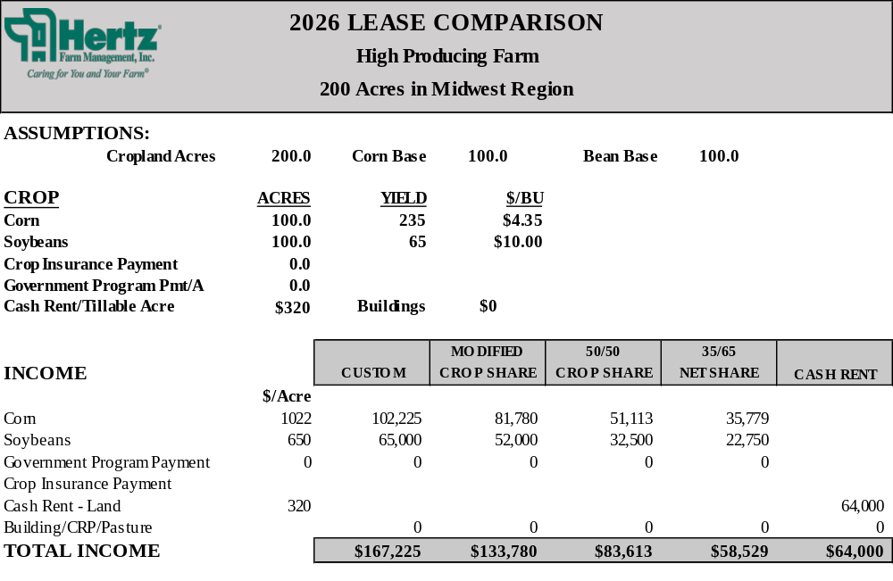

Slide 40
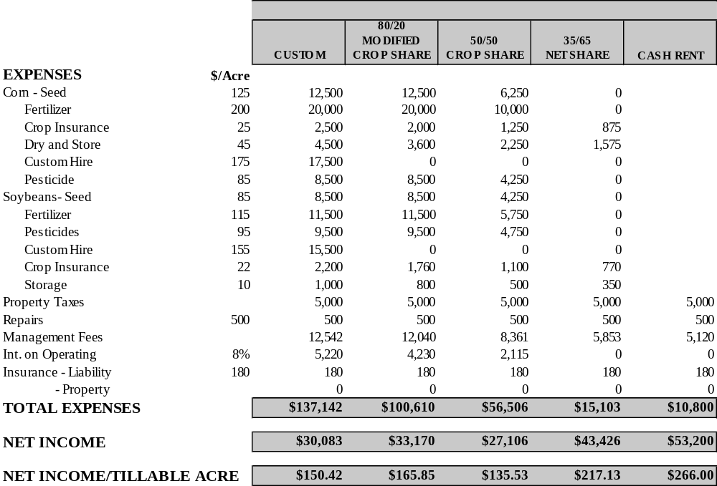

Slide 41
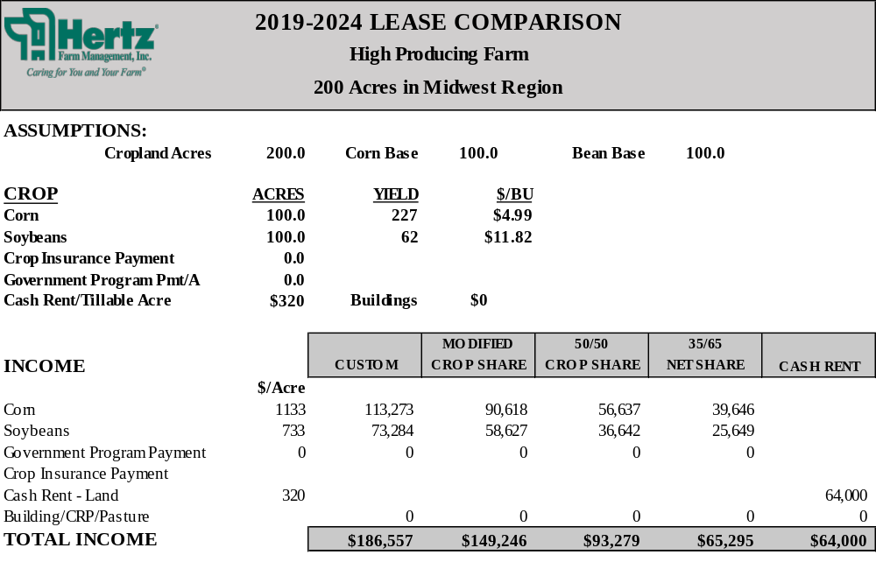

Slide 42


Slide 43

Where are rents headed?
2025 Crop Yields
Commodity Prices
Crop Input Costs
USA Trade Agreements
Government Payments
Farm Improvements
Notes:
ERP Payments

Slide 44
2026 Cash Rent Net Profit
High Yielding
  Corn Scenario
250 bpa corn yield
$4.35 per bushel price
$1,088 gross income
$606 in expenses
$482 profit before rent
Less $320 cash rent
$162 net profit
Simple average net profit = $70
Soybean Scenario
70 bpa soybean yield
$10.00 per bushel price
$700 gross income
$402 in expenses
$298 profit before rent
Less $320 cash rent
($22) net profit
Notes:
Expenses include seed, chemicals, fertilizer, insurance, drying, interest expense on inputs and machinery

Slide 45
2026 Cash Rent Net Profit Average Yielding
  Corn Scenario
225 bpa corn yield
$4.35 per bushel price
$979 gross income
$589 in expenses
$390 profit before rent
Less $320 cash rent
$70 net profit
Simple average net profit = $4
Soybean Scenario
65 bpa soybean yield
$10.00 per bushel price
$650 gross income
$392 in expenses
$258 profit before rent
Less $320 cash rent
($62) net profit
Notes:
Expenses include seed, chemicals, fertilizer, insurance, drying, interest expense on inputs and machinery

Slide 46
2026 Cash Rent Net Profit
Low Yielding
  Corn Scenario
200 bpa corn yield
$4.35 per bushel price
$870 gross income
$576 in expenses
$294 profit before rent
Less $320 cash rent
($26) net profit
Simple average net profit = ($64)
Soybean Scenario
60 bpa soybean yield
$10.00 per bushel price
$600 gross income
$382 in expenses
$218 profit before rent
Less $320 cash rent
($102) net profit
Notes:
Expenses include seed, chemicals, fertilizer, insurance, drying, interest expense on inputs and machinery

Slide 47
2026 Cash Rent Net Profit
High vs. Average vs. Low
Scenario | Corn Net Profit | Soybean Net Profit | Simple Avg. Net Profit
High Yielding | $162/acre | ($22)/acre | $70/acre
Average Yielding | $70/acre | ($62)/acre | $4/acre
Low Yielding | ($26)/acre | ($102)/acre | ($64)/acre
Notes:
Expenses include seed, chemicals, fertilizer, insurance, drying, interest expense on inputs and machinery

Slide 48
Where are rents headed?​
Average Cash Rents by State
Year | Illinois | Iowa | Minnesota* | Nebraska**
2025 | 300 | 271 | N/A | 215
2024 | 340 | 279 | N/A | 220
2023 | 353 | 279 | 245 | 230
2022 | 322 | 256 | 243 | 225
2021 | 265 | 232 | 223 | 238
2020 | 270 | 222 | 208 | 226
2019 | 263 | 219 | 206 | 225
2018 | 260 | 222 | 208 | 210
2017 | 260 | 219 | 210 | 220
2016 | 283 | 230 | 222 | 234
2015 | 295 | 246 | 226 | 247
2014 | 323 | 260 | 240 | 260
2013 | 339 | 270 | 232 | 280
*Average for Southern 1/3 of Minnesota
**Average for Center Pivot Irrigated Southwest Region cropland
Sources: Iowa State University, University of Minnesota, University of Nebraska, and ISPFRMA
Notes:
Need to complete highlighted section

Slide 49
Questions?
Thank You

Slide 50
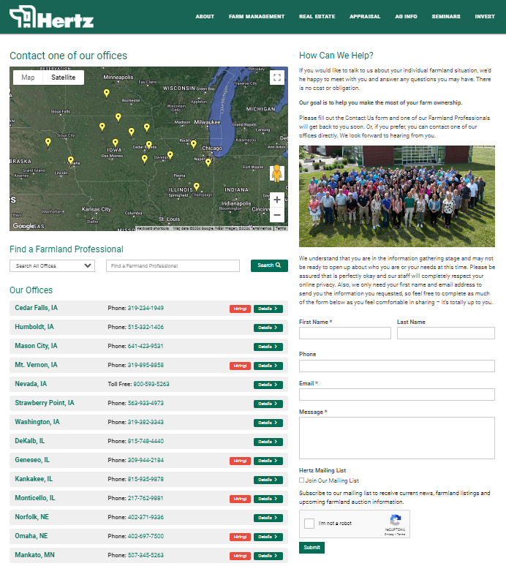


Stay Informed,
Connect With Us
800-593-5263 (LAND)
Contact@Hertz.ag
Follow us on Social Media
@HertzAgLand

